Slide 1

Three Step Approach for Building Employer Relationships

Slide 2
Poll question #1
A good strategy for job development is to:
Visit employers to ask about openings.
Visit employers to present information on the IPS supported employment program.
Visit employers to learn about their businesses.

Slide 3
Review: Three cups of tea
Learn about what is important to the employer
Learn about the workplace culture
Learn skills needed for different positions
Benefits:
Understand whether a position truly is a good match for the job seeker you know
Demonstrate to the employer that you want to help her find the right workers for her business.

Slide 4
Review: Three cups of tea
First cup of tea: Schedule an appointment
Second cup of tea: Return to learn about the employer’s business
Third cup of tea: Discuss a job seeker who may be a good match for the employer’s needs OR continue building the relationship

Slide 5
Value statement
When asking for an appointment to learn about the business, consider why would an employer want to do it—what’s in it for her? Then explain it to the employer.

Slide 6
Value statement
I am not looking for a job for anyone today. One of exiting parts of my job is to learn about the needs of employers and the type of job candidates they would like to meet in the future.”
"I help people who want to work find jobs that are the right match for their skills and personality. I'd love to meet with you for about 20 minutes in the next week or so to learn more about who is the right match for your business. I want to be sure that I only refer job seekers to your business if they are the type of workers you want to meet."
“If you are like most employers, you have learned about the type of person who is a good fit for your business. I want to know about the skills and personal characteristics of good employees at your business so that I can refer the type of person who will be a successful employee for you.”

Slide 7
#1. How to Schedule a Meeting
Writing an Introduction Statement Four Critical Elements
Your name
Your Employer
What you do
The purpose of your visit

Slide 8
Example
“Hello. My name is _______ (your name) and I work for Job Opportunities here in town. I’m an employment specialist and my job is to introduce employers to people who want to work and have the skills those employers need. Part of my job is to learn about local businesses. I am not necessarily looking for a job for someone today but would like to schedule a 20-minute appointment with you to learn more about what you do here and the types of people who tend to be successful here.”

Slide 9
Example
“Hello. My name is ______(your name) and I work for Mental Health Agency here in town. I’m an employment specialist and I help people who have been out of work to re-engage in the workforce. Part of my job is to lean from employers about their businesses and hiring preferences. Would it be possible to schedule a 15-minute appointment to come back and lean more about_______(name of business)?”

Slide 10
Your Introductory Statement
___________________________________________________________________________________________________________________________________________________________________________________________________________________________________________________________________________________________________________________________________________________________________________________________________________________________________________________________________________________________________________________________________________________________________________________________________________________________
Notes:
Ask for volunteers to read their intro statement. Practice Practice …..

Slide 11
Step 2 Returning to learn about the employer’s business
Good questions to ask in order to learn about the business

Slide 12
Questions about the business:
Why do you like working for ___________(name of business)?
What are your goals for (business or department)?
What sets your company apart from others?
What other questions would you ask?

Slide 13
Good Questions To Learn About an Employer’s Needs
Questions about the right job candidate:
What type of person tends to be successful here?
What qualities do you look for when you are interviewing job candidates?
What other questions would ask?

Slide 14
Good Questions To Learn About an Employer’s Needs
Questions about positions:
Please describe your workforce.
I see that you have ____positions. What other positions do you have that I may not know about?
What is a typical day like for a _______(name position)?
What other questions would ask?

Slide 15
Good Questions To Learn About an Employer’s Needs
Questions about the hiring process:
What is your hiring process?
So, people should start with an online application. But you mentioned that you need people who are self-starters with outgoing personalities. If you had a friend who matched that description how would you advise your friend to go about applying for work here?
What other questions would you ask?

Slide 16
Ineffective questions
Are you hiring?
Do you anticipate job openings in the future?
Do you hire people with criminal histories?
Do you hire people who have a substance use disorders?
What do you do here? (Learn this about the company before the appointment)
Are you laying off?
Notes:
Trainer pretend to be an employer. Pick a business you are familiar with and have participants practice asking you questions.

Slide 17
The focus is to listen and try to understand the workplace from the employer’s point of view. Be curious. Ask open-ended questions, use reflections, etc. You will know that the interview is going well if the employer is doing most the talking.

Slide 18
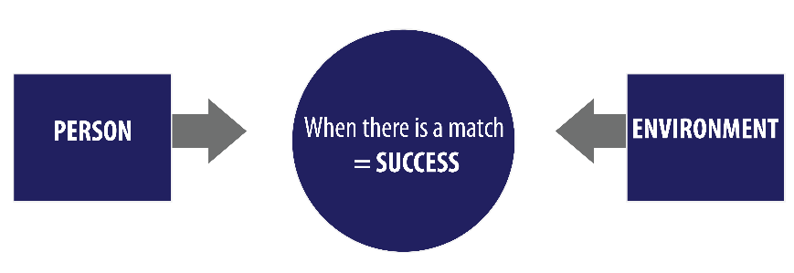
Video Good Galen

Slide 19
Questions about the workplace
Questions about the type of person who would be a good fit
Question about positions
It’s ok to stop here before asking questions about the hiring process

Slide 20
Top 5 Mistakes to Avoid During Meetings to Learn About an Employer
Asking about job openings
Interrupting the employer
Asking if the employer is open to hiring people with criminal histories
Speaking at length about your program
Neglecting to prepare for the meeting

Slide 21
After Meeting with the Employer
Write a thank-you note
Reflect on the stage of the relationship
Plan your next step

Slide 22
After Meeting with the Employer
If the employer seems like they might be interested, but it looks like they will not be hiring anytime soon, they still may be able to help you by introducing you to other employers. For example, they might introduce you to some of their suppliers, or they may be willing to participate in a steering committee meeting to educate members about employer needs. Or they might be willing to help a client with a mock interview. These steps can help further your relationship with the employer.

Slide 23
After Meeting with the Employer
If the employer appears interested in meeting people from your program now, or even at a later time when they expect to be hiring, return to talk about a person who might be a good fit for that business. “John, I’ve had time to consider your need to find people who are avid readers and would enjoy working with customers. I believe I do know someone similar to the person you described. Would you like to hear a little bit about her?” If you know the employer is not hiring, ask if they would be open to allowing the candidate to visit the workplace to learn more about that type of position—a 30-minute visit to observe workers and ask a few questions.

Slide 24
Step 3 Maintaining Employer Relationships Over Time
What is the goal?
What do you need to do, in order to be prepared?

Slide 25
Step 3 Maintaining Employer Relationships Over Time
Stay in touch with the employer every four to six weeks. Each time the employer sees you again, it reinforces the notion that you are interested in a long-term relationship and that you are reliable—you keep showing up! Further, don’t rely on busy employers to remember to call you when they have a job opening. Visit regularly so that you will hear about openings before employers advertise those jobs.

Slide 26
Maintaining Employer Relationships Over Time
Keep a list of 12-15 employers with whom you are building long-term relationships. Next to each employer, jot down the date of your most recent visit so that you can remember when you should return.

Slide 27
Examples of Ways to Maintain Employer Relationships
Return to share good news about your program. For example, an article in the paper about your program or a record number of job starts in the last quarter.
Return to let the employer know that you are working with someone who is interested in ___________work. Ask if the employer would be open to allowing the person to visit in order to observe and ask question about that type of positions.
Ask for a tour of the business.

Slide 28
More Examples of Ways to Maintain Employer Relationships
Return to share printed materials about your program, such as a brochure designed especially for employers
Return to congratulate the employer about an article that you read about their business.
Stop by to say hello and to ask the employer how business is going.
Return to let the employer know that you do know a candidate who would be a good fit for the business. “John, I know it’s important to you to find employees who want to work here because they are interested in books, and also people who are friendly and outgoing. I do know someone who fits that description. Would you like to hear a little bit about her?”

Slide 29

What Are Your Strategies to Sustain Employer Relationships?

Slide 30
Thank You
Sandy Reese
Sandra.reese@columbia.edu
www.ipsworks.org
This PowerPoint is to be used in conjunction with the Tips for Employer Relationships Building: A Guide for IPS Supported Employment Specialist booklet. Developed by: Sarah Swanson, Jerry Wood and Laura Flint.

