Slide 1

Discovering
Yourself
Tricia Jones-Parkin
Steve Blanks
This Photo by Unknown Author is licensed under CC BY-SA

Slide 2
Agenda
Introductions
A Different Approach
Relationships
Contributions
Going where it makes sense
Presentation Title

Slide 3
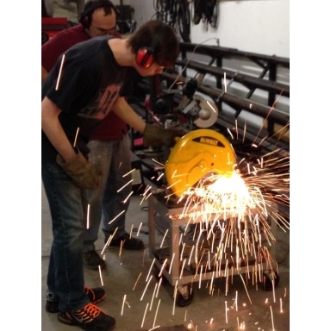
You May Stand or let us know however you prefer:
If you have ever had a job before

Slide 4
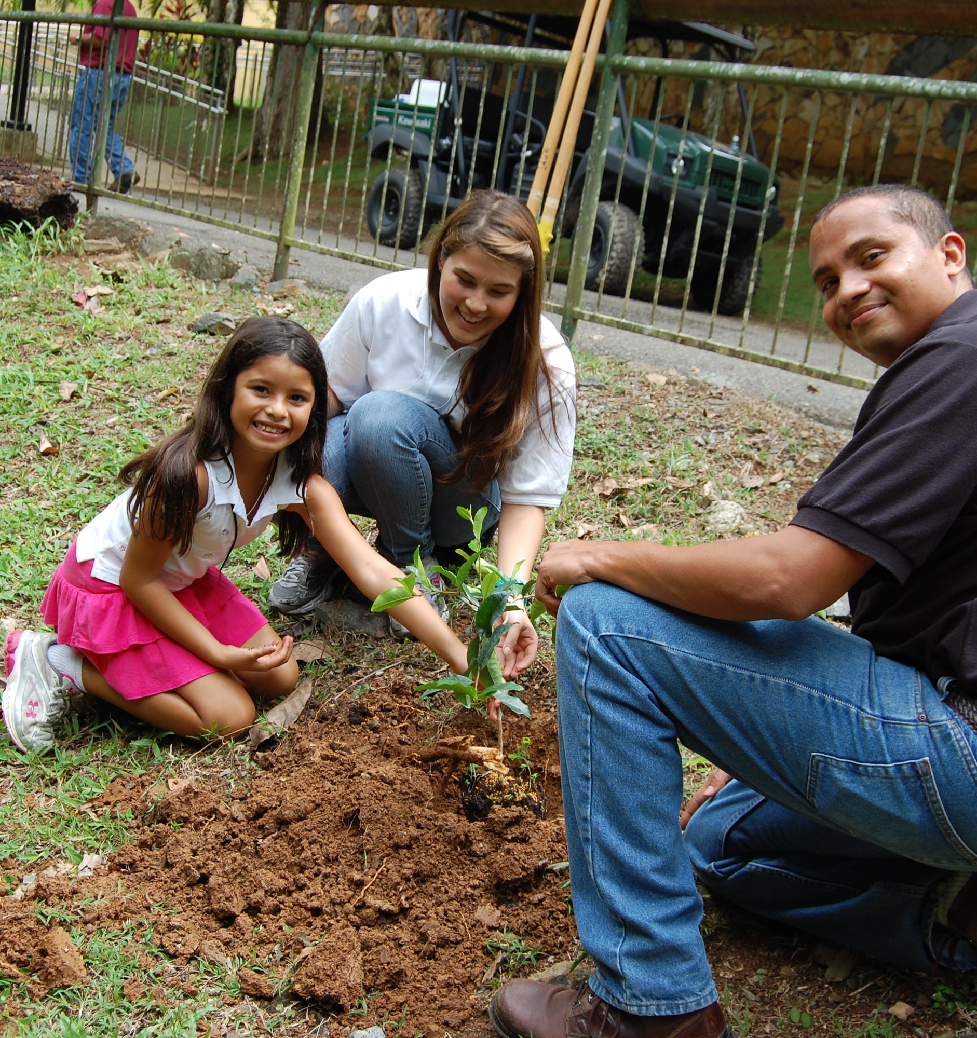
You May Stand or Let us Know
If you have ever volunteered somewhere
This Photo by Unknown Author is licensed under CC BY-SA

Slide 5

You May Stand or let us know:
Household Tasks

Slide 6

You May Stand or let us know:
If you know someone or have a family member who works

Slide 7

Congratulations! You are ready to dive in!
An employment seeker cannot “fail” Discovery.
(DFS 2018)

Slide 8

What is Customized Employment, and how is it different?
The process of Discovery is very collaborative
  Drawing on the strength of your community and relationships
  Team approach
  Not “jumping” to the job right away
  Using a visual resume or digital portfolio to share with potential businesses
  Want to find out who you are and where you are at your best
  Matching what makes sense for you AND businesses
Notes:
We are hoping to have conversations with people and draw information in an organic way. We are digging deep and trying to really understand who this person is and where they are at their best. We also really rely on existing relationships either directly with the jobseeker or their support system, so the employment specialist will be wanting to know a bit more about who the jobseeker is connected to, what they do for a living, etc. It may feel a little strange, but hopefully you are building trust and rapport along the way and we hope that you understand the employment specialists intentions are to really mine any and all possibilities that can be accessed.
From Michael Callahan white Paper, 2009
The term competitive used here does not refer to “integrated, community employment” as many practitioners have implied. Rather, competitive refers to the true competition that job seekers face regarding both the demands of the job, as defined by employers, and the efforts of other job seekers vying for the job. In work performed by United Cerebral Palsy Associations during the 1990s, it was found that even with effective job matching and strong job site supports many job seekers with the most significant disabilities – those with intellectual, physical and multiple impact regarding work performance – were not able to achieve “competitive” standards. And these were the same individuals who were also performing poorly on the comparative evaluations and assessments that had continued, in spite of the changes in the 1992 Amendments to the Rehab Act that no longer required individuals to prove their feasibility to benefit. However, it was found that if employer expectations and competitive job descriptions could be restructured, that virtually all individuals could make beneficial contributions to workplaces for which employers were willing to offer pay at or above the minimum wage.
Amy and Jason - add in anything you would like to say? Feedback from providers?

Slide 9
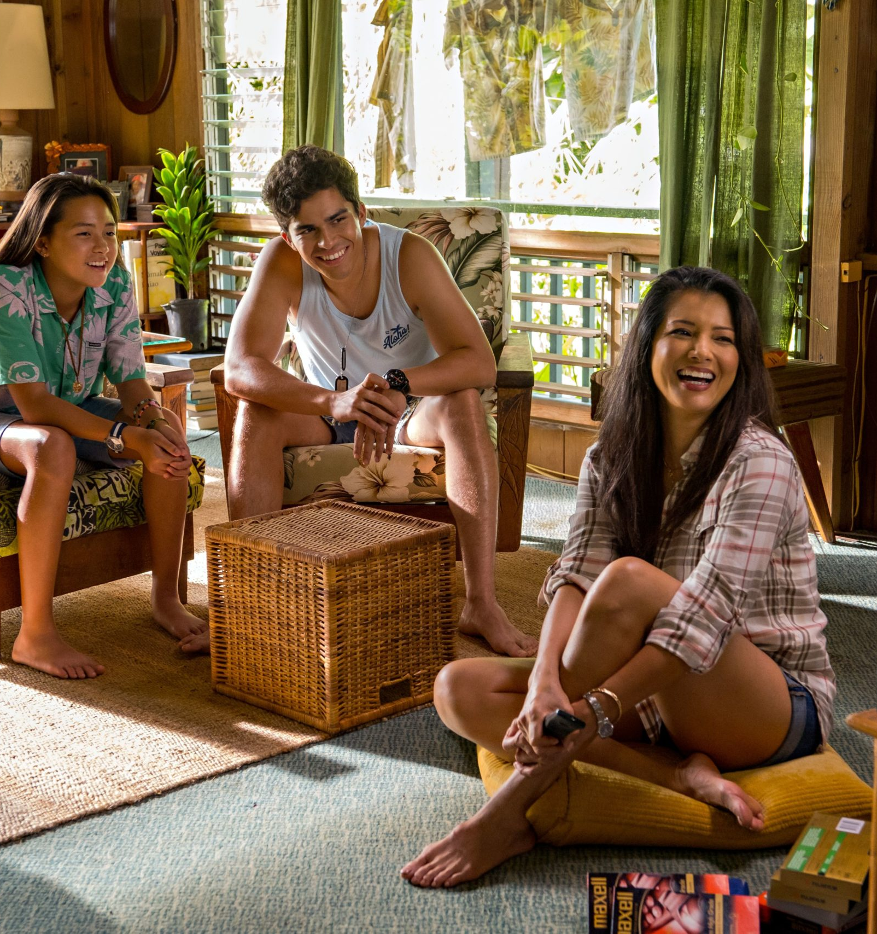
Relationships
Besides you, who knows you best?
What do they have to say about you?
What kinds of things do you do together?
Do you know what this person does for work?
Are there traditions you share?
This Photo by Unknown Author is licensed under CC BY-SA-NC

Slide 10
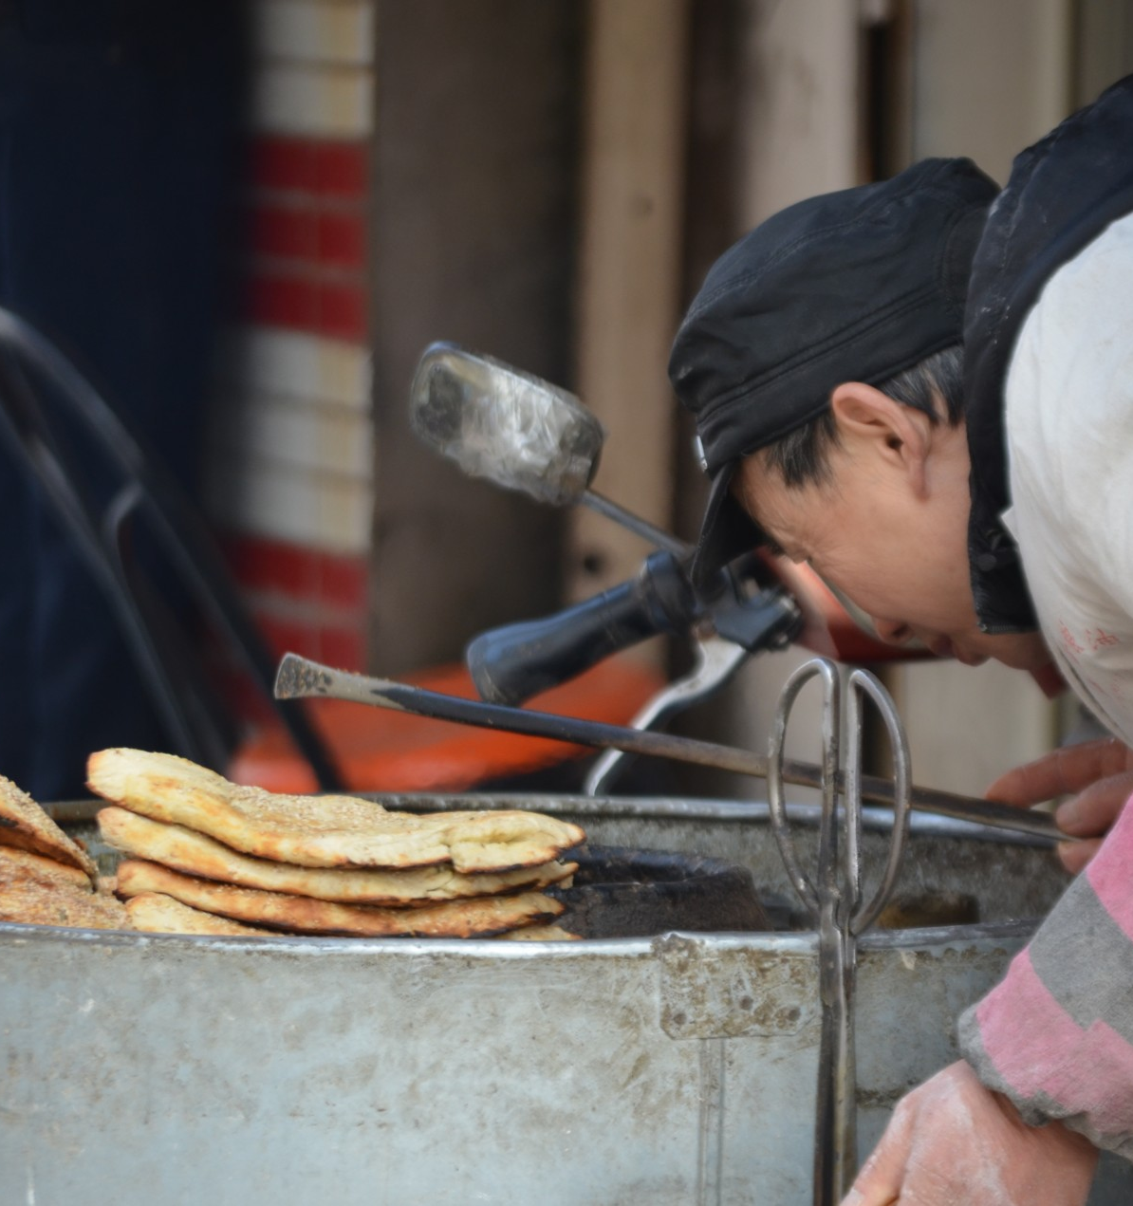
Contributions
When are you the most in flow?
What are you most proud of?
Sre there tools or technology you use?
Do you know and remember a lot of important information? (Birthdays, history)
What do you prefer to spend your time doing?

Slide 11

Going Where it Makes Sense- Preferences
What are the types of environments you prefer to be in?
What time of day are you at your best?
How do your learn best?
What are some tasks you would like to try?
What about health-related concerns?
Transportation- how does that impact where/when you work?
This Photo by Unknown Author is licensed under CC BY

Slide 12
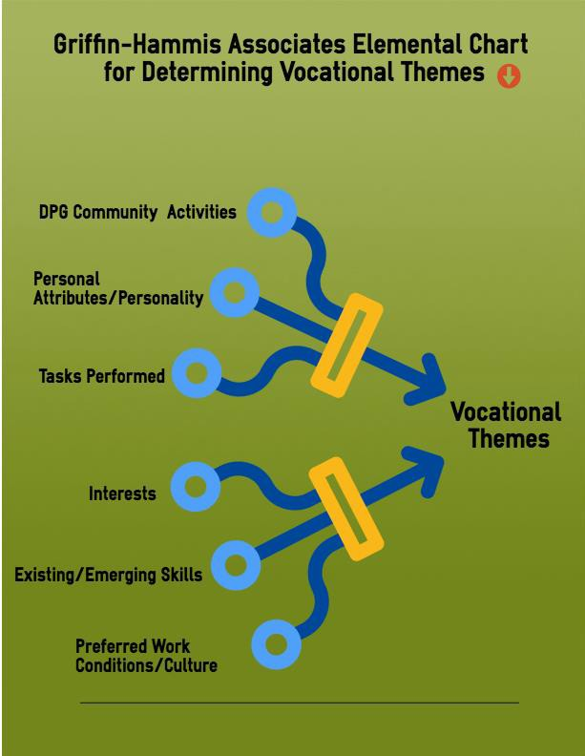

Going Where it Makes Sense- Vocational Themes
When are you the most in flow?
What are you most proud of?
Sre there tools or technology you use?
Do you know and remember a lot of important information? (Birthdays, history)
What do you prefer to spend your time doing?

Slide 13
Common Vocational Themes
Organization | Military | Athletics/Recreation | Water
Agriculture | Logistics | Culinary | Medicine/Health Care
Construction | Curiousity/Problem Solving | Art | Technology/Computers
Mechanical | Science | Fashion | Communications
Transportation | Religion/Spirituality | History | Geography
Cleanliness | Children | Politics | Leadership
Entertainment | Advocacy | Travel
Customer Service/Hospitality | Outdoors/Nature | Mathematics

Slide 14
Going where it makes sense- Vocational Themes AND potential businesses
Get advice from experts in the field to make sure you are on the right track!
Informational Interview
Find 3 places where the contributions you have to make are needed AND you there is potentially a need.
Go learn more!
Connect with people you may know

Slide 15
Thank you
Tricia Jones-Parkin
Tricia.jones@usu.edu ph 8013472299
Steve Blanks
Sblanks@seeconline.org
3013184948

