Slide 1
Blending, Braiding and Stacking Services and Supports
Karen Lee,
Economic Systems
US Department of Labor
Office of Disability Policy

Slide 2

Learning Outcomes
Introduction
Braiding
Blending
Sequencing

Slide 3
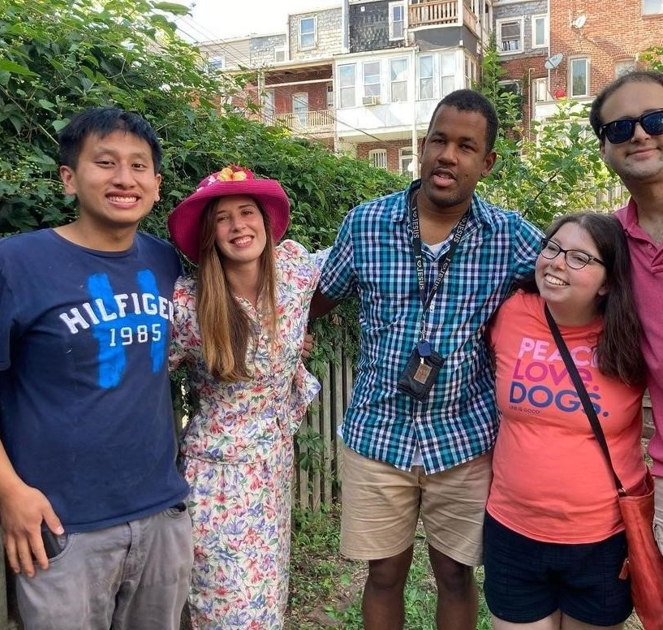
Introduction
People with disabilities and their families have been tremendous teachers in guiding professional how to braid, blend and sequence supports for their sons and daughters. Including family, neighbors, and community members in the life of the person so they can thrive takes coordination, creativity and reliance on others.

Slide 4
Braiding, Blending and Sequencing Services and Funding
Myth: Braiding, Blending and Sequencing funding is illegal and is considered double dipping.
Fact: The Federal Government not only approves of braiding, blending and sequencing of funding and services to build supports for people but encourages braiding, blending and sequencing.

Slide 5

Braiding
When more than one service, funding source or support is braided into someone’s life so they can succeed in achieving their personal goals.

Slide 6
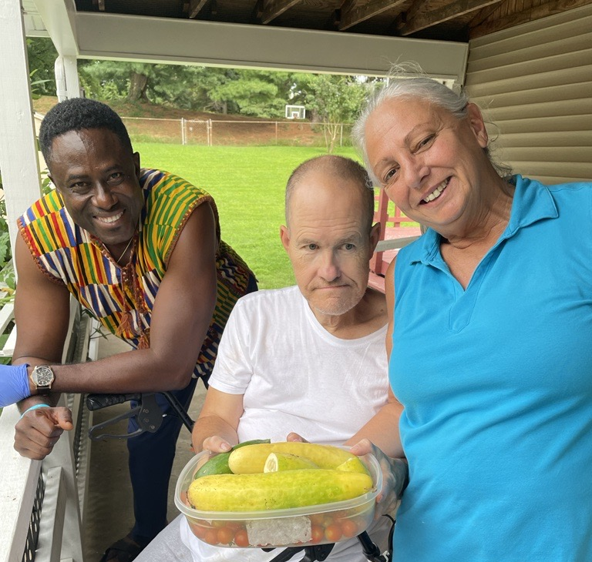
Braiding
David receives supports from several sources to live his best life:
Housing Opportunities
HCBS Waiver support
Vocational Rehabilitation
Medicaid State Plan
Social Security
County Recreation Scholarship
Community College

Slide 7

Braiding for Abby
The participant’s ISP may include a combination of DCP and other non-residential waiver services
Abby has been in a Day Habilitation service for years, but it has always been her dream to earn her own money so she can move in with her boyfriend. She is a fantastic cup cake baker and would like to pursue that career. But she has never made cupcakes for sale, never managed her own money and has always gotten a ride form her parents to the day center.,

Slide 8
Braiding for Abby
The participant’s ISP may include a combination of DCP and other non-residential waiver services
ISP Outcome Abby Wants:
learn more about her community and how to get around by herself
Explore the baking industry
Apply for a job
Keep doing her fitness and nutrition classes she goes to with her friends.

Slide 9
Braiding for Abby
The participant’s ISP may include a combination of DCP and other non-residential waiver services
Hawaii DVR: Job Development
Hawaii DDD: Discovery and Career planning, Financial Literacy, Individual Employment Services (job coaching), community learning service group and individual

Slide 10

Blending
Definition
Graduation
When different funding sources are put together in the same bucket to get the desired outcome.
Project Search
Supported Living Supports

Slide 11
Project Search is an example of Blending
Classroom
Internship
Funding
School teacher or classroom instructor
Aid in the classroom often is a job coach
Learning about budgets, dating, use of technology, self regulation, transportation
Three internships in 9- month program
Job carving
Job coaching
Skill development
Work behaviors
VR pays for the internship through Pre-ETS, Community Engagement or other work adjustment funds
Classroom supports and job club funded through waiver/state plan Medicaid funds or private pay

Slide 12
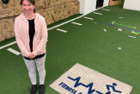

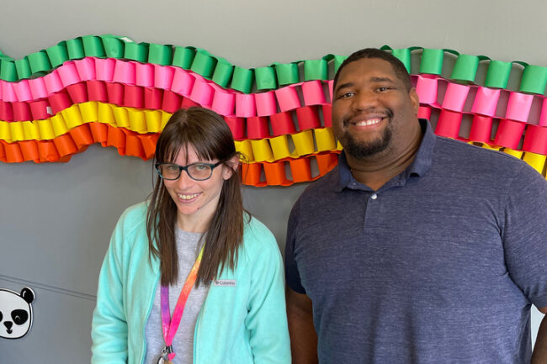
Sequencing
Sequencing can happen when services are planned in a way that feed into the next service.
Day Hab
Community Learning Service
Discovery
Job Development
Job Coaching
Community Learning Service

Slide 13
Barriers to Braiding, Blending and Sequencing
The organization doesn’t have a relationship with all the funding sources.
The agency does not have the infrastructure to do all the services in the process.
Case managers don’t have experience in blending services.
Self-advocates and families don’t know how to ask for the blended services
Funding sources don’t have an MOU that creates an obvious opportunities to sequence.

Slide 14
Questions
Karen Lee
klee@seeconline.org

Slide 15
Thank you
Presenter name
Email address
Website

