Slide 1
IPS Overview
Honolulu Hawaii
February 29, 2024
Sandy Reese

Slide 2
Individual Placement and Support (IPS) Is
Effective

Slide 3
28 Randomized Controlled Trials (RCTs) of Individual Placement and Support (IPS)
Best evidence available on effectiveness
Studies conducted all around the world
RCTs are gold standard in medical research
(Bond, Drake & Becker, 2012)

Slide 4
Characteristics of RCTs of IPS
12 U.S. studies and 16 outside U.S.
2/3 of studies had at least 18-month follow-up
Total enrollment = 6,468 participants
In most studies, participants mainly recruited from community mental health services
In most studies, the control group received services as usual (sometimes best practices)

Slide 5
Competitive Employment Rates in 28 Randomized Controlled Trials of IPS

Slide 6
Overall Findings for 28 RCTs
Every one of 28 studies showed a significant advantage for IPS
Mean competitive employment rates for the 28 studies:
55% for IPS
25% for controls

Slide 7
People in IPS attain employment faster, hold jobs for longer, and work more hours.
IPS is more effective than alternative vocational approaches regardless of a variety of client background factors. (e.g., ethnicity, gender, socioeconomic status)

Slide 8
IPS Fidelity Review
A fidelity scale is a tool to measure the level of implementation of an evidence-based practice (EBP).
The IPS Supported Employment Fidelity Scale defines the critical ingredients of IPS in order to differentiate between programs that have fully implemented the model and those that have not.
As demonstrated through research, high-fidelity programs are expected to have greater effectiveness than low-fidelity programs.
You can think of the IPS Supported Employment Fidelity Scale as a roadmap or a compass that can help practitioners obtain better outcomes.

Slide 9
IPS Supported Employment Practice Principles

Slide 10

Competitive jobs are the goal

Slide 11
IPS supported employment/ education services are closely integrated with mental health treatment services

Slide 12
Eligibility is based upon client choice

Slide 13
Employer contact begins rapidly after clients enter the program

Slide 14

Employment specialists build relationships with employers based upon client job interests

Slide 15
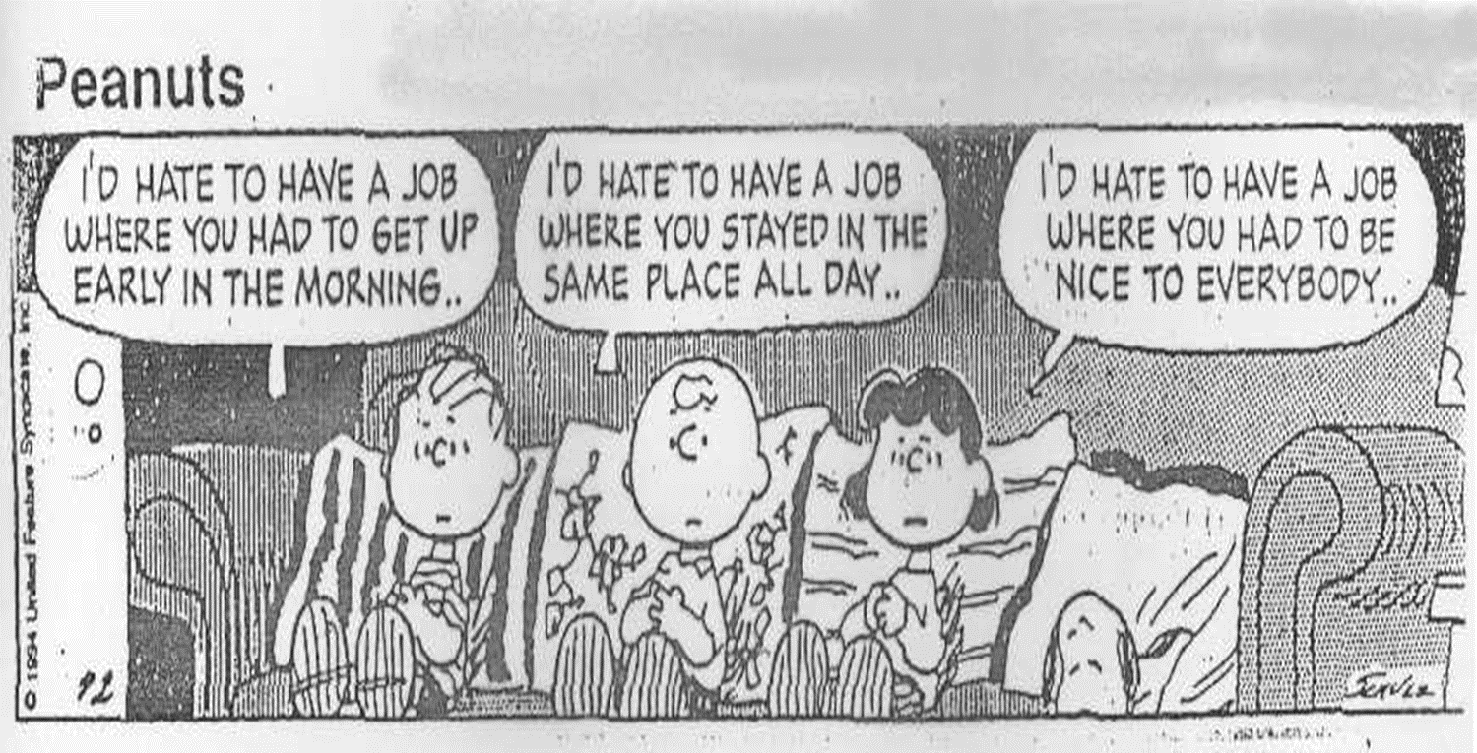
Consumer Preferences are Honored

Slide 16

Job supports are continuous

Slide 17
Benefits planning (work incentives planning) is offered to all clients that receive entitlements

