Slide 1
How Does Providing Evidence-based Supported Employment Impact Social Determinants of Health?
Hawaii
February 29, 2024
Sandy Reese

Slide 2
What is the connection between employment and health?
“Employment is a critical mental health intervention.”
Drake and Wallach (2020)
Notes:
Working is often mentioned by clients in describing their recovery process. For example:
J. Bailey, “I’m an Ordinary Person,” Psychiatric Rehabilitation Journal, 22, (1998), 8-10.
Rogers, J. A. (1995). Work is key to recovery. Psychosocial Rehabilitation Journal, 18(4), 5-10
Steele, K., & Berman, C. (2001). The day the voices stopped. New York: Basic Books.
Hierarchy of needs: Maslow, A. H. (1970). Motivation and personality (2nd ed.): Harper & Row.
Working is not the only adult role for adults in our society, but it is clearly very important. It is each client’s choice whether or not he/she would like to pursue work, but mental health centers should make it possible if it is their choice.

Slide 3
Social Determinants of Health
Access to quality healthcare
Access to quality education
Social and community context
Neighborhood and built environment
CDC for Disease Control and Prevention
CDC 24/7: Saving lives, Protection People

Slide 4
Social Determinants of Health
Economic stability:
The connection between the financial resources people have - income, cost of living and socioeconomic status – and their health. This area includes key issues such as poverty, employment, food security and housing stability.
CDC for Disease Control and Prevention
CDC 24/7: Saving lives, Protection People

Slide 5
Mortality rate for people with mental illness
According to the World Health Organization, people with serious mental health disorders die 10-25 years earlier than the general population.
The vast majority of deaths of people with serious mental illness are preventable.

Slide 6
Higher risk of illness
People with mental illness have increased risk of heart disease and other preventable conditions due to:
Poverty, social isolation and trauma
Lack of access to quality health care
Psychopharmaceutical effects
Substance use
Tobacco
Obesity
SAMHSA: What Health Providers and Organizations Need to Know About Wellness

Slide 7
How might employment reduce risk factors for preventable illnesses?
Reduce poverty, social isolation and trauma: Earned income and a sense of contributing and belonging to the community.
Improve access to quality health care: Employer paid benefits.
Psychopharmaceutical effects: IPS team works closely with the person’s prescriber in order to coordinate treatment.

Slide 8
How might employment reduce risk factors for preventable illnesses?
Substance use: Employment gives people a sense of purpose, a reason to get up in the morning and reduces substance use.
Tobacco: Most employers do not allow smoking on the job.
Obesity: Employment fills in for boredom and sedentary time.

Slide 9
Discussion
How do you see employment impacting health risk factors for people with behavioral health conditions?

Slide 10
Positive Impact of Competitive Employment for People with Mental Illness
Benefits of work for people with mental illness similar to those for general population:
  increased self-esteem, improved financial security, reduced mental health symptoms, less social isolation, reduced substance use, and reduced health care costs
(Drake, 2020; Gibbons, 2019; Luciano, 2014)
Notes:
Working is often mentioned by clients in describing their recovery process. For example:
J. Bailey, “I’m an Ordinary Person,” Psychiatric Rehabilitation Journal, 22, (1998), 8-10.
Rogers, J. A. (1995). Work is key to recovery. Psychosocial Rehabilitation Journal, 18(4), 5-10.
Steele, K., & Berman, C. (2001). The day the voices stopped. New York: Basic Books.
Hierarchy of needs: Maslow, A. H. (1970). Motivation and personality (2nd ed.): Harper & Row.
Working is not the only adult role for adults in our society, but it is clearly very important. It is each client’s choice whether or not he/she would like to pursue work, but mental health centers should make it possible if it is their choice.

Slide 11

If employment is good, why is there such a large disparity between statewide employment rates and the numbers of people with mental health conditions working?

Slide 12
This is the 2022 Uniform Reporting System (URS) Output Tables for Hawaii. The URS state reporting system is collected annually to support the Community Mental Health Services Block Grant program. State Mental Health Authorities report on National Outcome Measures (NOMS), evidence-based practices, and utilization measures providing an overview of state mental health delivery systems.
 | General Population | People with Mental Illness | Difference
Employment Rate in United States | 96.3% | 21.7% | 74.6%
Employment Rate in Hawaii | 96.5% | 14.4% | 82.1%
Target group for IPS services!
Notes:
For people 21-64

Slide 13

There’s probably a lot of people with mental illness who want to work, but may need help to reach their goal

Slide 14
Need for Employment Services
Over 60% of people with serious mental illness want to work, but less than 20% employed.
Only 2% of people who could benefit have access to effective employment services.
Expressed Interest in Employment
Reported in 11 Surveys

Slide 15
Question:
If work is so good for people, then why isn’t it seen (along with housing) as a central focus of the public mental health system?

Slide 16
Funding Employment Services
There typically is not one source of funding for employment services but instead a need to braid funding.
Medicaid
Medicaid Waivers
Vocational Rehabilitation
State Block Grant $

Slide 17
Leadership Buy-in for IPS
Successful implementation of IPS and other evidence-based practices depends upon strong leadership for the new program, as demonstrated by the National Evidence-Based Practices Project.

Slide 18
Provider Misinformation
Lack of understanding about SSI/SSDI benefits planning.
Many providers were taught that “work is too stressful.”
What comes first mentality “we are not saying that people shouldn’t work but they need to be housed or in treatment first.”
Notes:
If you think working stressful have you ever been unemployed?

Slide 19
People are their own best judges of when they are ready to work
Research has demonstrated that desire to work helps people overcome many different barriers to employment.
Most of us are unable to reliably predict who can work.
Employment is a human right.
Effects of poverty are terrible– people live on the fringes of their communities, poorer health, less self-esteem, depression, legal problems, more substance use.

Slide 20

When we don’t ask people about employment, does that send a message? What message?

Slide 21
Since we know that work is good for overall health, what can we do?
Self examination: What message do you give staff and clients about the importance of employment? Has leadership communicated how employment (IPS) supports the mission of the agency and helps clients with their recovery.
Include questions about interest in employment on agency intake and treatment plans.
Display written postings (e.g., brochures, bulletin board, posters) about working and IPS employment services in the lobby and other waiting areas.
Ensure that people being served are offered assistance in obtaining comprehensive benefits counseling.

Slide 22
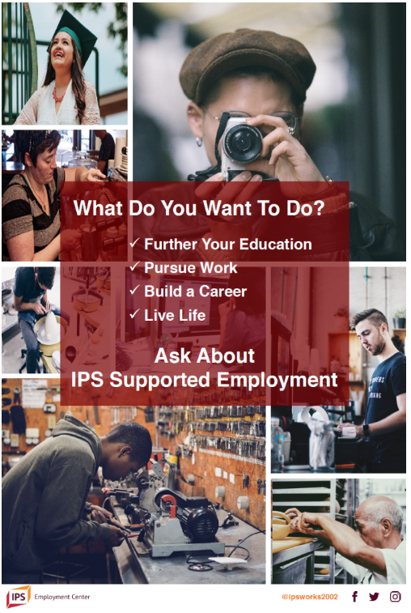


Slide 23
Support ways for people being served to share work stories with other participants and staff
  Kickoff event with agency leadership, staff, people that receive services, Vocational Rehabilitation, and funders.
  Provide opportunities for participants to share their back to work stories in agency groups, social events, staff events, and other gatherings.
  Have an employer come to the agency to share about their workplace and what they look for in candidates.

Slide 24
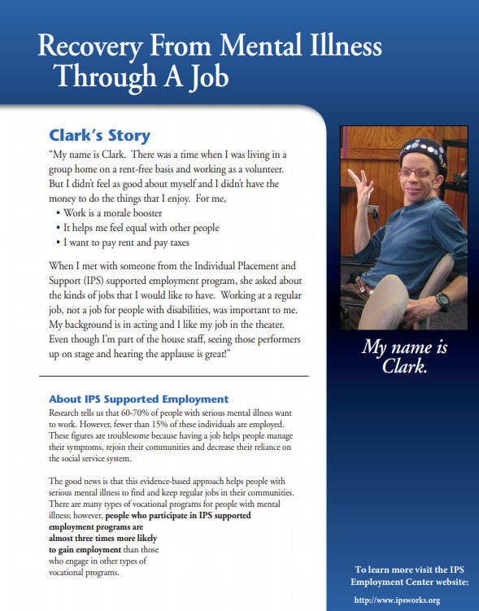
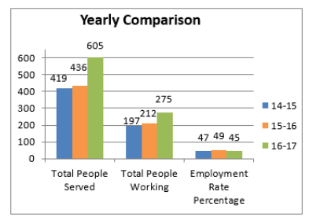
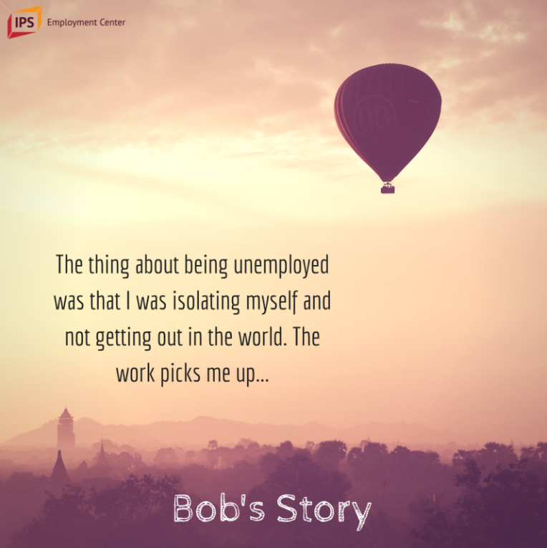
Quiz- True or False

Slide 25
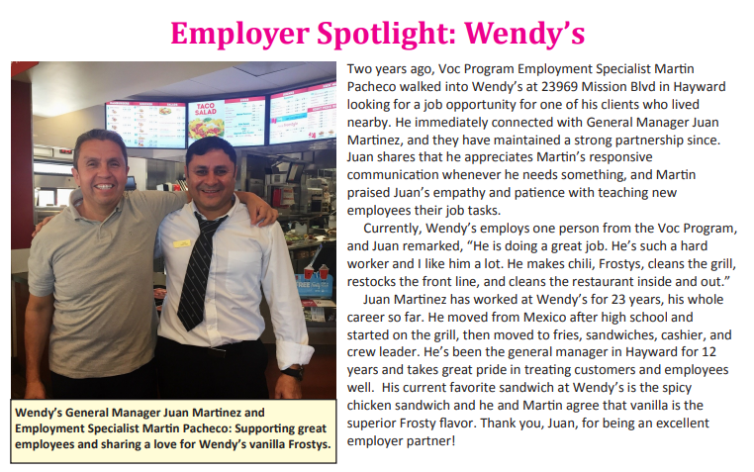

Slide 26
Collect and Report Data
Agencies can track how many people are working and analyze annual trends.
IPS programs can share information on numbers of people enrolled in IPS, people working, in school, how many job starts, etc.
Data can be shared with mental health teams, vocational teams, agency leadership, State and regional MHDS, Vocational Rehabilitation, and other stakeholders.

Slide 27
Guard against the tyranny of low expectations
Does leadership pay attention to low expectations (what would you do if your son or daughter came home and told you that they could no longer work)?
Are there conversations about helping people to create exit plans?
What is your definition of recovery for people with behavioral health conditions?

Slide 28
How do we fund IPS employment services
The key is to partner and collaborate across silos.
Get all stakeholders (e.g., Vocational Rehabilitation, Medicaid, State and Regional MCO’s), to sit down at a meeting and discuss a state plan to support IPS services.

Slide 29
Provide strengths-based services
The strengths-based approach was developed in response to the predominantly deficit-based medical model in mental health. Rather than seeing people with mental illness as permanently deficient, the strengths-based approach highlights people’s assets and potential for recovery. Focusing on people’s strengths improves the client-specialist relationship and vocational outcomes.

Slide 30
What can mental health staff do to promote employment?
Sometimes, mental health practitioners ask all of their clients about work, but are unsure what to do if a person says “No.”
Think about a variety of ways to ask how employment might fit into the person’s life.
How would your life be different if you worked? What would be some good things about being employed? The not so good things?
How would a job affect your relationships with other people?
What are your skills and strengths?

Slide 31
Mental Health Practitioners could also ask:
Would you like to learn more about our employment services?
Would you like me to introduce you to one of our employment/education staff?
Would you like to hear how your benefits would be impacted by returning to work?

Slide 32
Change program services to accommodate working people’s schedules
Are psychiatrists available after 5 p.m.?
Are support groups and counseling sessions available after 5 p.m.?

Slide 33
What can mental health staff do to promote employment?
If employment is a person’s treatment plan goal, it’s everyone’s business to help them, not just the employment staff.
Be creative and brainstorm good job matches according to the person’s strengths, skills, and previous employment history.
Keep your eyes open for potential jobs and share leads with the employment staff.

Slide 34
Quotes From IPS Participants
“When you are working, you are part of the real world. You feel connected. Having a job gives me stability. I have something to look forward to every day.”
“In the past, people might have used labels to describe me such as ‘homeless,’ ‘mentally ill,’ and ‘welfare mother.’ Now my titles are ‘financial administrator,’ ‘college student,’ and ‘working mom.’”

Slide 35

Questions

Slide 36
Thank You
Sandy Reese
IPS Employment Center
Sandra.reese@nyspi.columbia.edu
www.ipsworks.org

