Slide 1
Sample Title Page
Employer Engagement
Hawaii Employment First Summit- Professional Track
February 29, 2024
Presented Name Last Name

Slide 2
Overview of Practices
Relationship Building-How our thinking needs to shift
Engagement Framework 4 Phases of Employer Journey
Emerging practices around employer engagement

Slide 3
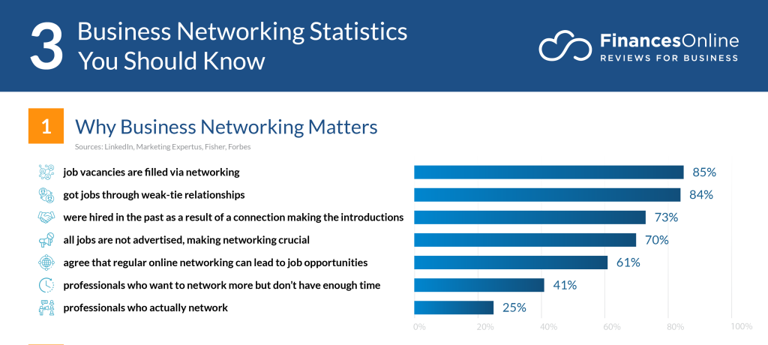

Why is Engagement Vital Up to 85% of jobs are filled via networking
This Photo by Unknown Author is licensed under CC BY-SA-NC
Notes:
Is this true here in Hawaii?

Slide 4
What Needs to Shift
Shift practices to a “dual customer” approach-job seekers AND employers
Change language
Change approach
Shift thinking to relationship or partner development (not just about jobs)
What’s in it for them (WIIFT vs WIIFM)
Understanding business practices
Establish opportunities for co-creation with businesses
Business Advisory Councils
Business-Centric internships (eg Project Search)
Provider Coalitions
Inclusive Business-Driven Entities-DisabilityIN, etc

Slide 5
What is Customer Engagement?
Employer or Partner
“….the process of building a relationship between a business and its customers”
“…a process you can use to build trust and loyalty with your customer base”
“…the process of interacting with customers through a variety of channels in order to strengthen your relationship”
Source: https://www.intercom.com/blog/customer-engagement/ https://fluentsupport.com/customer-engagement-best-practices-examples/ https://blog.hubspot.com/service/customer-engagement-guide

Slide 6
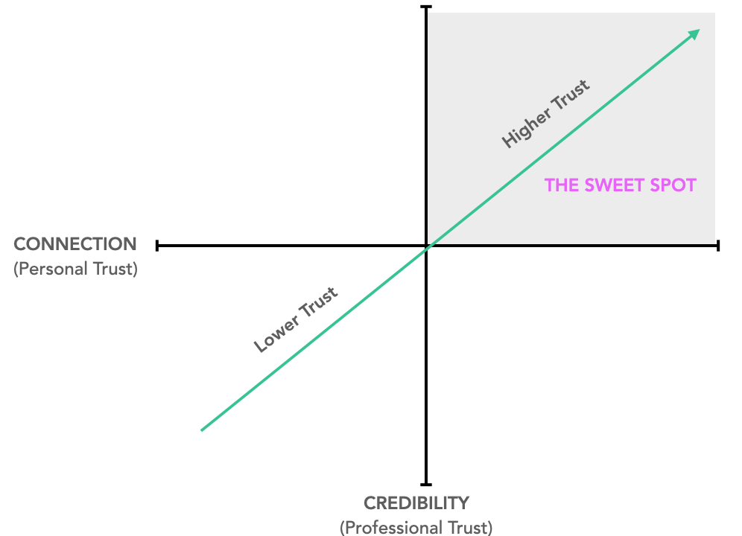
Partner Development
Partner
Friend
Sponsor
Champion
Customer

Slide 7
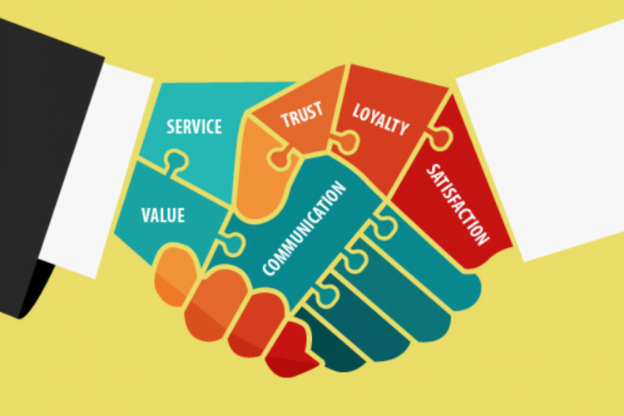
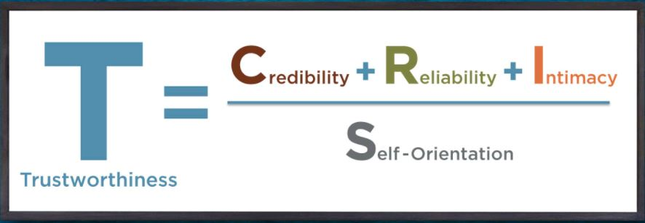
Trusted Advisor
Source: Trusted Advisor, David Maister

Slide 8
Think yourself a “Trusted Advisor”….
Increase Credibility
1. Show you’ve done your homework.
2. Take a point of view.
3. Speak the truth … always.
Increase Reliability
4. Combine your words with presence.
5. Make lots of small promises.
6. Be on time.
7. Use their terminology.
Develop Intimacy
8. Be willing to name the proverbial elephant in the room.
9. Listen with empathy.
10. Tell them something you appreciate about them.
11. Address people by name.
Lower Self Orientation
12. Give away ideas.
13. Build a shared agenda.
14. Steer clear of premature problem-solving.
15. Relax your mind.
Source: Trusted Advisor, David Maister

Slide 9





Relationship Building-It’s About Giving NOT TAKING
Listen more than talk (GIVE)
Share your expertise (GIVE)
Ask How You Can Help (GIVE)
Be Your Genuine Self (GIVE)
Notes:
Adam Grant Book……

Slide 10




Major Phases of the Employer Journey-5 Cs
Connection
Consideration
Conversion
Continuation
Champion
Adapted from: How to Master All 5 Stages of Customer Journey https://www.goldenvineyardbranding.com/blog/stages-of-the-customer-journey/

Slide 11
Connection-Raising Awareness
Stakeholder Activities | Persons with Disabilities | Families | Providers | Employers | Sector/ Industry Leaders | State Officials/ Schools
Share Employment Stories | X | X | X | X | X | X
Provide Education | X | X | X | X | X | X
Share Testimonials | X | X | X | X | X | X
Invite to Industry Groups/Biz Groups |  | X |  | X | X
Post in Social Media | X | X | X | X | X | X
Invite to NDEAM events |  |  | X | X | X | X
Develop Marketing Materials (videos, etc) |  |  | X | X | X | X
Notes:
Where in Hawaii can one raise awareness? There is a chamber…are there more locally oriented business/community groups? What are some other ways you’re currently raising awareness

Slide 12
Consideration- Ways to further the conversation
Stakeholder Activities | Persons with Disabilities | Families | Providers | Employers | Sector/ Industry Leaders | State Officials/ Schools
Invite Provider(s) in to see the Jobs |  |  | X | X | x
Create Professional Mentoring Options |  |  | X | X | X | X
Create Work-Based Learning Options |  |  | X | X | X | X
Join Provider Business Advisory Council |  | X | X | X | X | X
Provide Business Tours |  |  | X | X | X
Create Career Exploration Options |  | X | X | X | X
Hear from Successful Employer Activities | X | X | X | X | X | X
Notes:
Invite to an event/activity/info session
Host a career exploration activity
Host a worksite tour
Host work trial
Host an intern for short working period
Joining a job club to share career/professional experience
Become a mentor for a job seeker
Conduct mock interviews
What other ways can providers, employers, the support system deepen the understanding, see the actual successes, etc

Slide 13
Conversion- How to get the win-win or a job match
Stakeholder Activities | Persons with Disabilities | Families | Providers | Employers | Sector/ Industry Leaders | State Officials/ Schools
Host An Intern | X |  | X | X
Create An Internship Program (e.g Project Search) | X | X | X | X | X | X
Create Work-based Learning Options
Hire a Job Seeker | X |  | X | X |  | X
Customize a Job |  |  | X | X
Accommodate an Employee | X |  | X | X
Tell Employment Story | X | X | X | X | X | X
Notes:
Have to see the job (smell it, touch it, taste it….)
Have to understand ‘pain points’ & challenges
Have to create clear path for new employee to be successful (gap analyses, systematic instruction and fading plan)
Negotiation for “win-win”

Slide 14
Continuation-Deepening Relations
Stakeholder Activities | Persons with Disabilities | Families | Providers | Employers | Sector/ Industry Leaders | State Agencies/ Schools
Co-Create NDEAM Celebration/ Recognition Events | X | X | X | X | X | X
Co-Create Social Media Postings | X | X | X | X | X | X
Co-Create Collaboratives | X |  | X | X |  | X
Join Regional/State Leadership Councils | X | X | X | X | X | X
Invite Peer Employers to Learn More |  |  | X | X | X
Co-Create Testimonials | X | X | X | X | X
Co-Create Articles for Industry Journals |  |  | X | X | X
Notes:
Celebrate and Recognize
NDEAM events and activities
Social Media shout outs
Inform and Educate
Leverage off the shelf materials- ODEP, EARN, UK
Invite and Engage
Provider/state level board and committee involvement
Provider/state level solicitation and feedback
Testimonials (written and via video)
Engagement Activities
Mock Interviews
Career/Professional mentoring
Info Interviews
Kentucky’ State Chamber…led by one of the Talent Pipeline team held an Inclusive Workforce Summit for employers….what’s interesting there is the industries and businesses maybe more ready than some of the vocational system (providers, schools, VR, etc) which is a great problem to have.

Slide 15
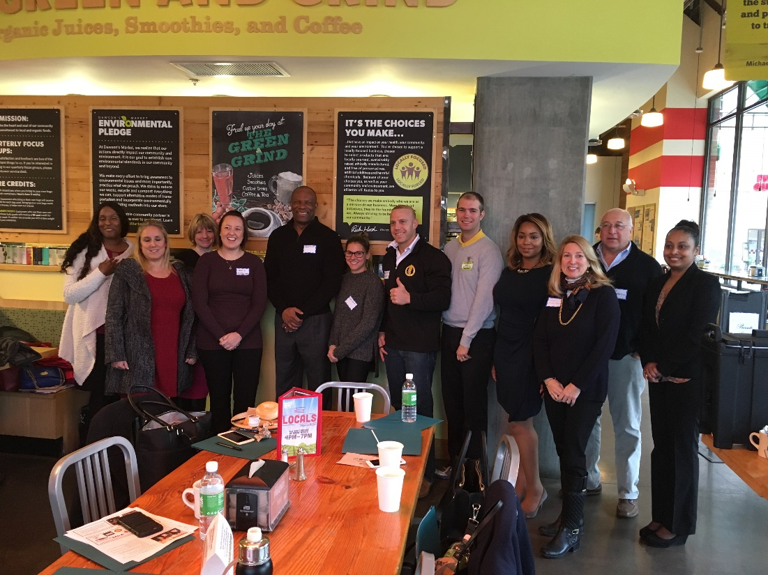
Continuation-Best Practices Business Advisory Councils
A Business Advisory Council (BAC) is a motivated group of local business and community professionals who assist in….
General Networking
Business-orientation
Marketing feedback
Strategic feedback
Industry connections/invites

Slide 16



Provider Collaboratives- possible solution to help bridge providers-employers
Employers
2014
2018
2010
Community Providers
Job Seekers
https://www.employmentcollaborative.com/
https://coalitionfwd.com/
https://www.linkedin.com/company/mogatewaynexus/
Notes:
Coalition in Lousville has been around over a decade, connected 100s of jobs. Nexus is a statewide, and state sponsored collaborative broken into 19 sub groups bringing employers and providers together for info, sharing, and education…and the one I have had the most interaction with the Cuyahoga Collaborative around Cleveland heralds over 200 employer relationships, made up of over 60 non profit and local agencies

Slide 17

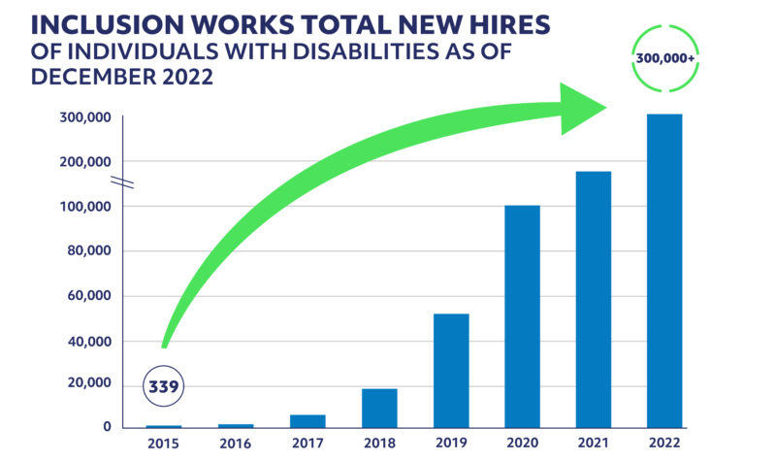
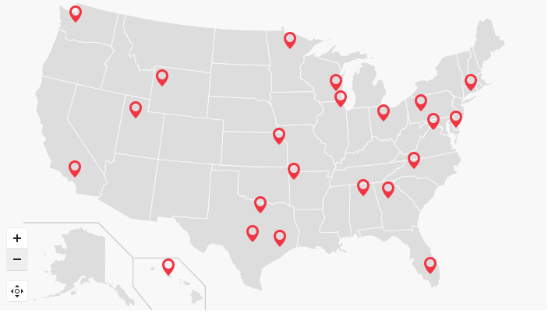



Disability Consultants- Another network of connectivity with larger employers
Notes:
Disability IN HI has 28 organizations from state, non profit and for profit businesses already established and should be a resource to help with networking, and systematic awareness building and engagement of some of the larger corporations….don’t see some of the nationwide partners like the hospitality giants of Hilton, Marriott

Slide 18





Embrace the “Bridgers”- Ever growing group of businesses focused on alternative staffing solutions
Job Seekers
Employers
Notes:
JEC over 30 years in development….branched out 10-15 years ago….working with Fortune 500 companies, but also small and mid sized organizations SourceAbled is part of Rangam….has 600 jobs identified as possible openings for persons with disabilities, special focus in IT, Life Sciences, Public positions, telco, etc

Slide 19
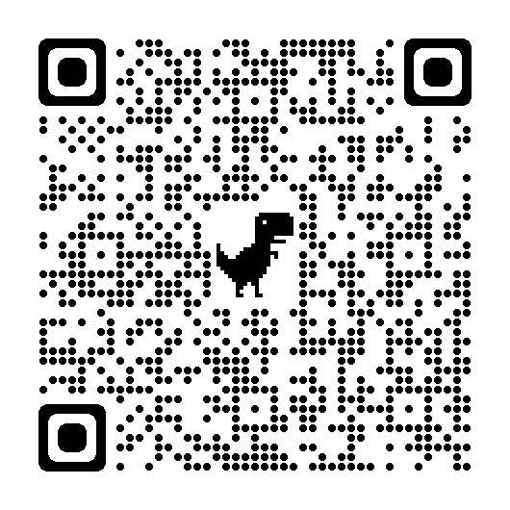
Steve Blanks
Director of Partnerships
SEEC
sblanks@seeconline.org
https://www.linkedin.com/in/steve-blanks-5a16474/details/skills/?detailScreenTabIndex=0

Slide 20
Resources
TedTalk-Building Trust- https://youtu.be/s9FBK4eprmA
Touchpoints Article https://www.linkedin.com/pulse/how-many-touches-does-take-make-sale-2022-jennifer
Jed Seifet and Stakes LLC work https://impressionsmagazine.com/build-your-business/management/ask-the-experts-jed-seifert/ https://www.apparelist.com/2022/07/12/stakes-manufacturing-wins-award-for-disabilities-inclusion-program/
Collaborative Links
Louisville Coalition https://coalitionfwd.com/
Gateway Nexus https://www.linkedin.com/posts/mogatewaynexus_activity-7044303823108018176-Xj_T/
Cuyahoga Collaborative https://www.employmentcollaborative.com/
Disability Consultants
SourceAbled- https://jobs.sourceabled.com/
James Emmett Consulting https://jamesemmettandcompany.com/

Slide 21
Drill Down on 4 phases on engagement
Connection….is awareness…..biggest feedback is people haven’t heard about us?
Consideration….what are the steps to deepen relationship
Invite to mock interview
Work site visit and observation
Meet a job seeker
Join an employer event
Conversion….might be a low risk trial, internship, etc…..all the way up to hire…might be several steps
Continuation…how well do we provide our services….and how well do we continue to care about their business (recognition, marketing, supporting, etc)

Slide 22
Of course you can just ask ChatGPT
Establish Partnerships
Educate and Raise Awareness
Match Job Seekers to Actual Jobs
Customize and Carve Jobs to best suit Job Seekers AND meet the needs of the employers
Provide High Quality “On-the-job” support
Recognize and Celebrate
Source: ChatGPT prompt “Please share some best practices for employer engagement as it relates to supported and customized employment for people with disabilities
Notes:
Establish partnerships: Build relationships with employers who are committed to diversity and inclusion.
Education and awareness: Conduct training sessions for employers to enhance their understanding of disability-related issues and promote a more inclusive work environment.
Job matching: Identify and communicate the skills, abilities, and interests of job seekers with disabilities to employers. Focus on aligning the strengths of individuals with the needs of the employers, ensuring a good match.
Job carving and customization: Work with employers to identify tasks or job roles that can be modified or customized to suit the skills and abilities of individuals with disabilities.
On-the-job support: Provide ongoing support and accommodation to employees with disabilities to ensure their success in the workplace..
Disability etiquette: Educate employers and co-workers on disability etiquette and appropriate communication strategies. Recognition and celebration: Recognize and celebrate employers who actively support and hire individuals with disabilities. Highlight success stories and share positive outcomes to encourage other employers to follow suit.

Slide 23
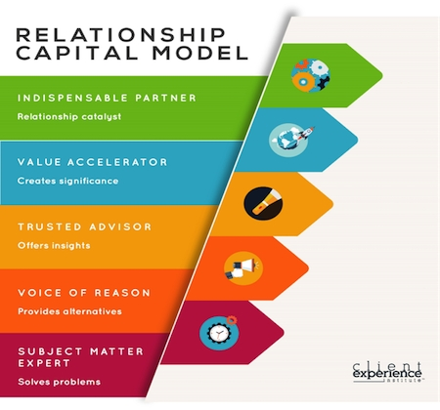
What is Relationship Capital

