Slide 1
Building Infrastructure for Implementation and Dissemination of IPS
Honolulu Hawaii
February 29, 2024
Sandy Reese

Slide 2
Site Level Tips for Successful IPS Implementation
Leadership matters
Hire IPS specialists who are hopeful, persistent, and want to work in the community.
Hire IPS supervisors who value employment and want to work in the community.
Track outcomes.
Use fidelity as a roadmap for better implementation.

Slide 3
State Level Strategies
State Partnerships
IPS Trainers
Funding Plan
Measuring Implementation – Fidelity
Outcome Tracking
IPS Supervisor Meeting

Slide 4
The Mental Health-VR Partnership is Key
Each partner brings something to the table:
VR counselors know about many types of jobs/careers, and they know about secondary disabilities and chronic health conditions. Based on an individual’s employment plan, they may be able to help with practical resources.
IPS specialists have small caseloads and can provide individualized, side-by-side services.
IPS participants are served by an integrated treatment team which often includes prescribers, therapist, case managers, co-occurring treatment and offers long term supports.
IPS teams and VR counselors meet monthly to discuss how to help individuals succeed at their goals.

Slide 5
IPS State Trainer Overall Function
Assists agencies in making organizational and programmatic changes to implement and sustain Individual Placement and Support (IPS) programs. Conducts IPS fidelity reviews that occur every 6 months for agencies in the “fair” or below range and annual for agencies in the “Good” and above range. Provides training and consultation to practitioners and agency leaders. Works with local and state offices of Vocational Rehabilitation to improve collaboration between mental health agencies and Vocational Rehabilitation (in the U.S). Participates in state/regional IPS leadership meetings and provides feedback about IPS barriers and facilitators.

Slide 6
IPS Fidelity Review
A fidelity scale is a tool to measure the level of implementation of an evidence-based practice (EBP).
The IPS Supported Employment Fidelity Scale defines the critical ingredients of IPS in order to differentiate between programs that have fully implemented the model and those that have not.
As demonstrated through research, high-fidelity programs are expected to have greater effectiveness than low-fidelity programs.
You can think of the IPS Supported Employment Fidelity Scale as a roadmap or a compass that can help practitioners obtain better outcomes.

Slide 7
Most programs in IPS Learning Community meet fidelity standards
(Bond et al., 2012)

Slide 8
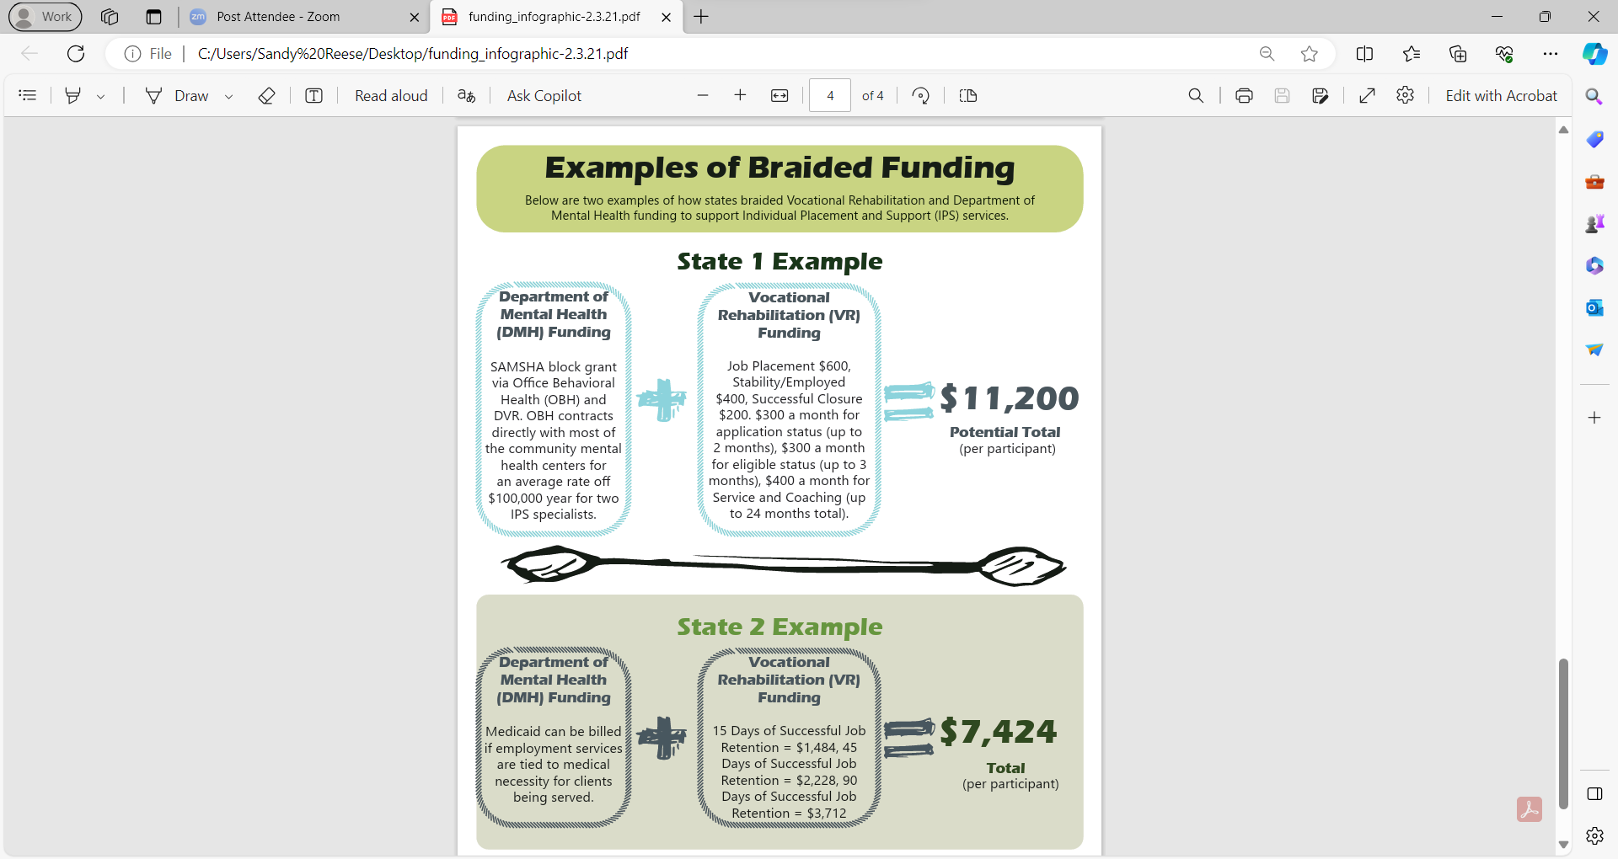

Slide 9
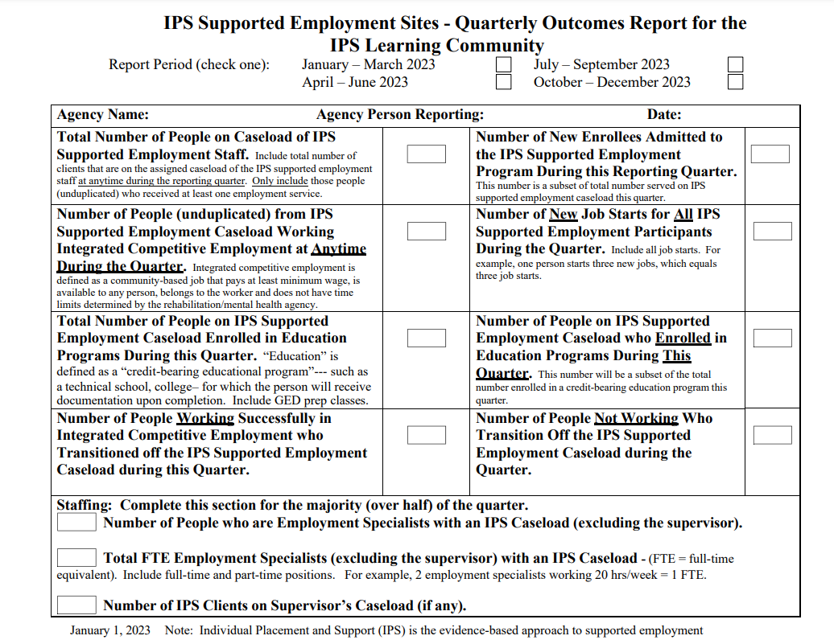

Slide 10
IPS Supervisor Meetings
IPS supervisors meet on a state-by-state basis to discuss trends, share challenges and brainstorm strategies to improve outcomes.

Slide 11
The International IPS Learning Community
Members learn about new strategies to implement and sustain IPS.
There are regularly scheduled international calls with stakeholder groups, fidelity reviewers and trainers.
There are occasional opportunities to participate in research studies.
Programs share outcomes so all members can see the average employment rate and number of job starts that they can use as a benchmark.
Members learn about new trends: Expanding IPS to new populations of people, Medicaid for IPS, IPS in housing programs, etc.

Slide 12
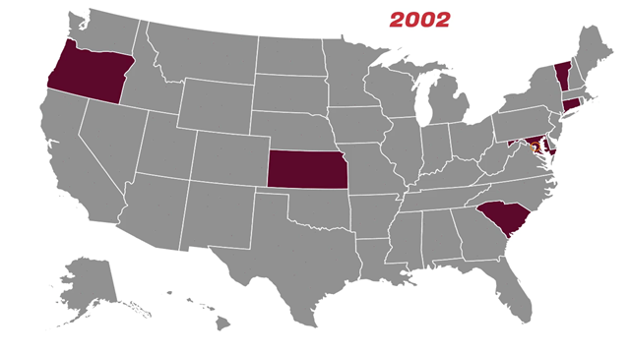

Slide 13
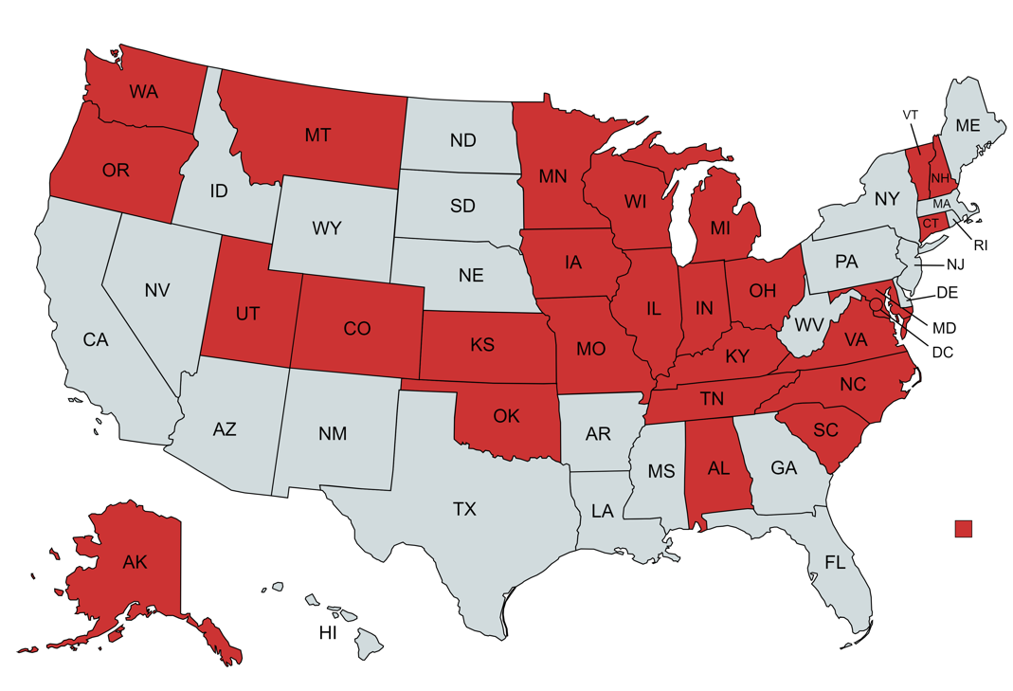
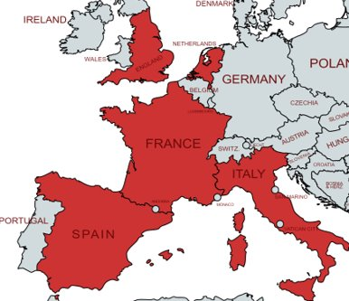

International IPS Learning Community​ As of January 2024​
Montreal QC, Canada
Alameda County, CA
Broward County, FL
Notes:
27 STATES, 2 COUNTIES AND 7 COUNTRIES

Slide 14
Thank You
Sandy Reese IPS Consultant and Trainer
Sandra.reese@nyspi.Columbia.edu
www.ipsworks.org

