Slide 1
Building and Sustaining employment support Services
2023

Slide 2
Managers and Supervisors
To change a culture into one that is more LEAN and far more efficient, we need to make a shift from traditional training models, instead focusing our energy and resources into the development of mentored managers and supervisors who have the capacity to change service delivery by actively growing team members.
Managers and supervisors are a critical resource within an organization, as they not only provide stability and continuity through higher retention rates; they are in the unique position to directly affect quality improvement.

Slide 3
Establishing a Vision for Employment Development Team
Helps set priorities and facilitates goal setting.
Clearly states, “this is who we are, this is what we
do, and this is where we are going.”
Viewing “Employer Engagement” as a continuum.

Slide 4

Navigating the Landscape
The business of doing business with business!

Slide 5

TWO WORLDS

Slide 6
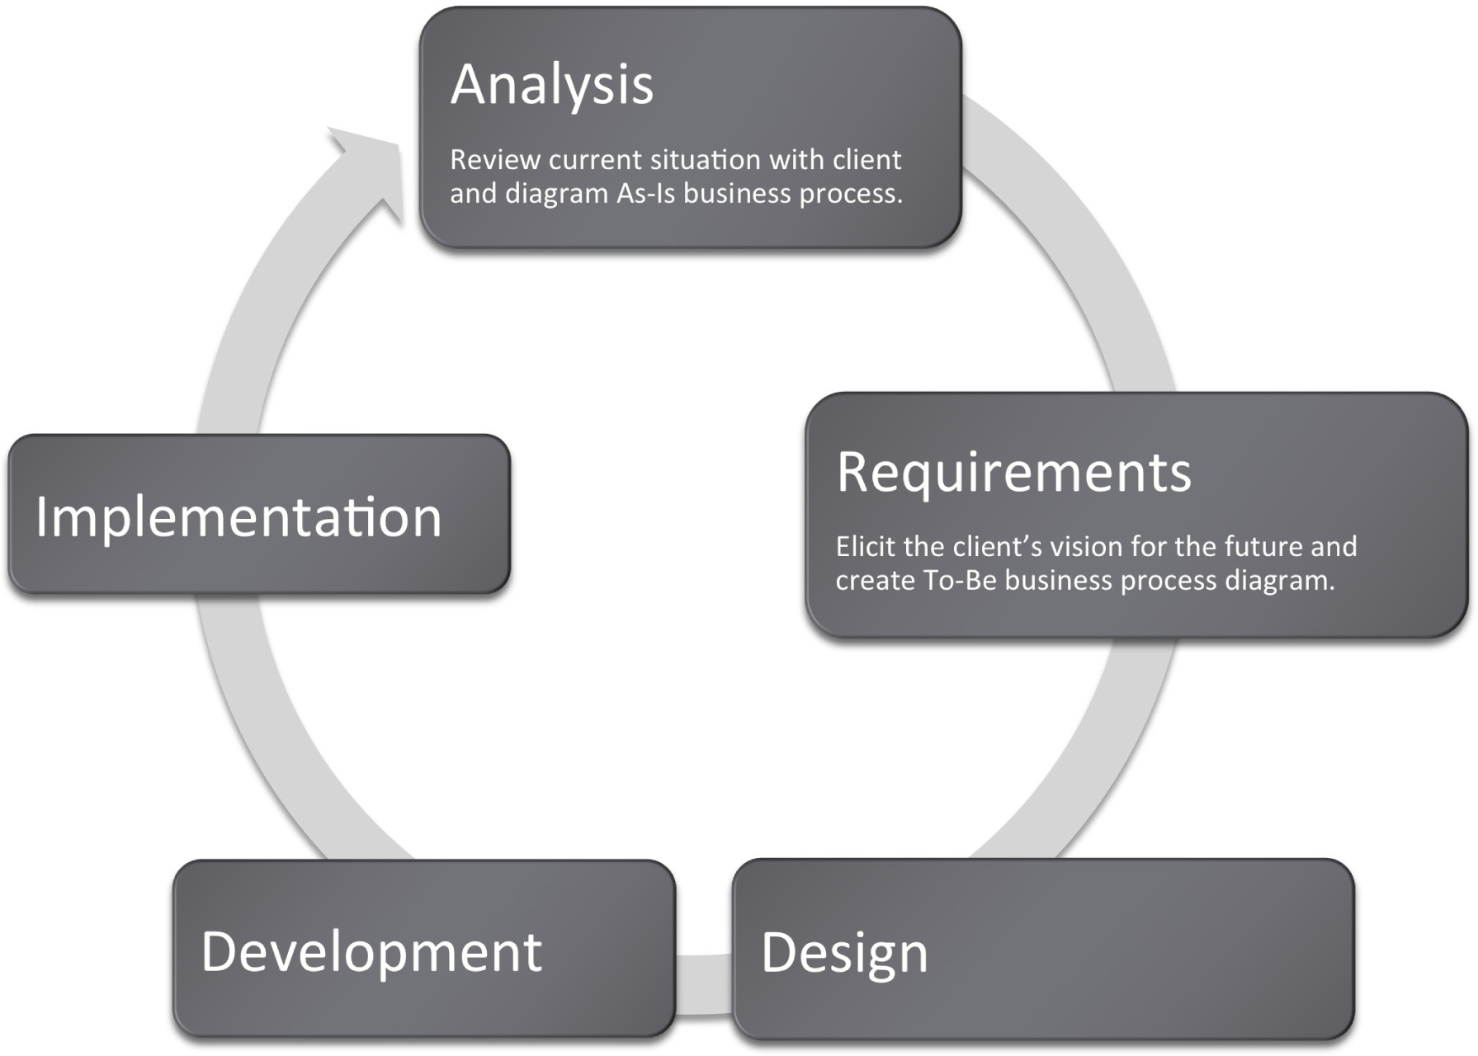
Supervising and Coaching EMPLOYMENT DEVELOPMENT Services
This Photo by Unknown Author is licensed under CC BY-SA-NC

Slide 7

Organizational Infrastructure
A tree that will bear no fruit –
The infrastructure must be consistent with the targeted goals and objectives. Community-based competitive employment is not the moving of the present programs to another venue. Team resources, team assignments, and team competencies are consistently directed toward targeted goals and objectives.

Slide 8

Managing A dynamic Team

Slide 9

TOOLS
Employment Services Core Competencies and Training Modules
Standard Operating Procedures and Practices
Training Curricula/Trainer’s Guides for Managers
Consistent Service Delivery Tools for Employment Team Members

Slide 10

Managing the Day to day of Employment Services

Slide 11
Three Customers
Job Seeker

Slide 12
Three Customers
Employer
Job Seeker

Slide 13
Three Customers
Funding Source
Employer
Job Seeker

Slide 14

Job Match

Slide 15

The secret to success!

Slide 16

The 10 yard mile!

Slide 17

Programs

Slide 18
Employment Flow
Referral
High Quality Assessment of Wants and Needs
Plan
Follow Up
Job
Match
Initial Contact
Informational Interview
Proposal
Service After the Match
Network

Slide 19
Employment Flow
Referral
High Quality Assessment of Wants and Needs
Plan
Follow Up
Job
Match
Initial Contact
Informational Interview
Proposal
Service After the Match
Network

Slide 20
Employment Flow
Referral
High Quality Assessment of Wants and Needs
Plan
Follow Up
Job
Match
Initial Contact
Informational Interview
Proposal
Service After the Match
Network

Slide 21

Allocating Resources
NETWORKING

Slide 22
Allocating Resources
NETWORKING
FORMAL
INFORMAL
JOB
SEEKER
TEAM MEMBERS

Slide 23
Allocating Resources
NETWORKING
FORMAL
INFORMAL
JOB
SEEKER
TEAM MEMBERS

Slide 24
Allocating Resources
NETWORKING
FORMAL
INFORMAL
JOB
SEEKER
TEAM MEMBERS

Slide 25
Allocating Resources
NETWORKING
FORMAL
INFORMAL
JOB
SEEKER
TEAM MEMBERS

Slide 26


MANAGING RESOURCES

Slide 27




Stages of Employment Development
Informational Interview/Relationship Building
Initial Contact
Proposal
Service After the Match

Slide 28

Dating?

Slide 29

Initial Contact - Considerations
Who are you?
What do you want?
WIIIFM

Slide 30
Employer File
DEMOGRAPHICS
CONTACT INFORMATION
RELATIONSHIP MANAGEMENT PLAN
CULTURAL ASSESSMENTS
JOB SKILL INVENTORY (JSI)
FLOW CHARTS

Slide 31
Stages of Employment Development
Informational Interview
Initial Contact
Proposal
Service After the Match

Slide 32

Relationship Building through Informational Interviews
See the job
Know the direct supervisor
Know the culture and flow

Slide 33

Informational Interview Goals
Assess job/s
Assess the culture
Know your customer
Be welcome back

Slide 34
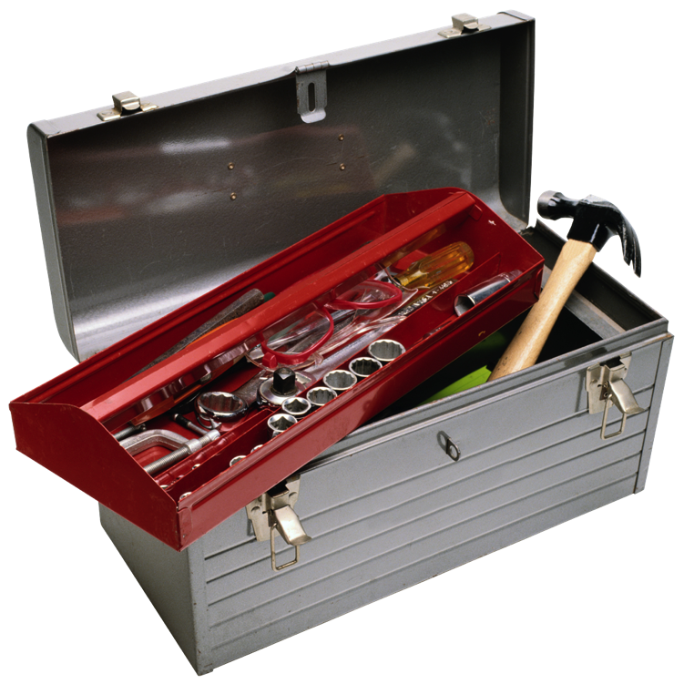
Tools
Skill Inventories
Cultural Assessments
Task and Sequence Analysis
Flow charts and diagrams

Slide 35
Stages of Employment Development
Informational Interview
Initial Contact
Proposal
Service After the Match

Slide 36
Employment Flow
Referral
High Quality Assessment of Wants and Needs
Plan
Follow Up
Job
Match
Initial Contact
Informational Interview
Proposal
Service After the Match
Network

Slide 37
Proposal Goals
Know the person
Know the job
Know the resources
Present a clear plan

Slide 38
Proposal - Considerations
Verbal presentation of the proposal
Provide written proposal
Know the resources and look for creative options

Slide 39
Gap Analysis
Tool for anyone attempting to increase a person’s performance
Structures the proposal and follow up
Documentation that manages the relationship with all stakeholders

Slide 40
GAP Analysis TOOL
Job Requirement | Person/Status | Supports |  | Progress

Slide 41
Skills in the Tool Box
JOB MODIFICATION, JOB RESTRUCTURING, and TRAINING
TASK and SEQUENCE ANALYSIS
FLOW DIAGRAMS
TECHNOLOGY

Slide 42
EMPLOYERS
NO
MAYBE
YES
Development

Slide 43
Stages of Employment Development
Informational Interview
Initial Contact
Proposal
Service After the Match

Slide 44
Marketing Plan
AGENCY/ORGANIZATION
MANAGEMENT
TEAM MEMBERS
EMPLOYMENT DEVELOPER

Slide 45
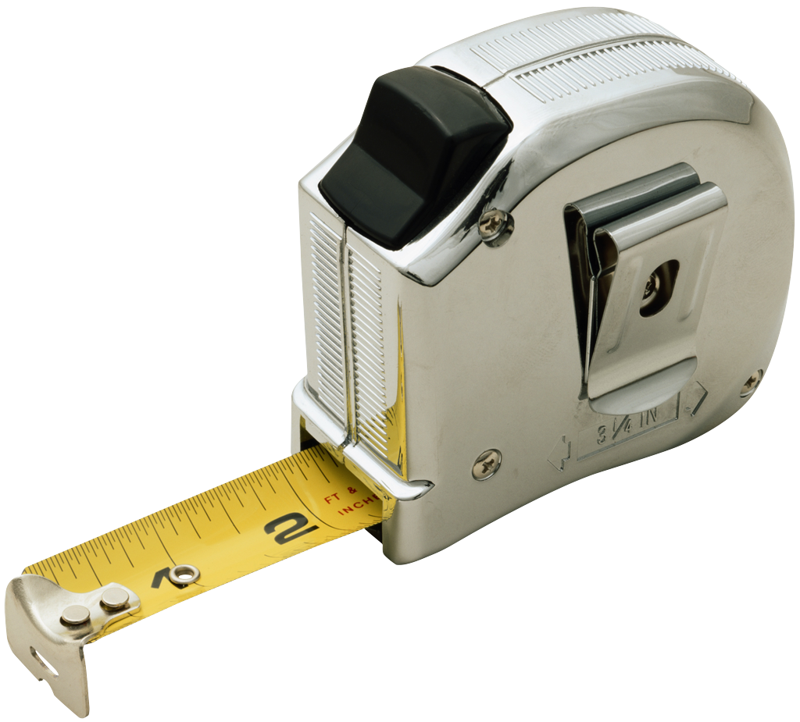
Metrics

Slide 46

Data Driven Processes
Clearly defined program assessment and evaluation
metrics (e.g. Employer Satisfaction Tools).
Established competencies and standards of quality
service for every level of the organization
Performance reviews for managers are tied to the
program metrics and team member development
Performance reviews for team members mirror
targeted competencies and quality of service

Slide 47
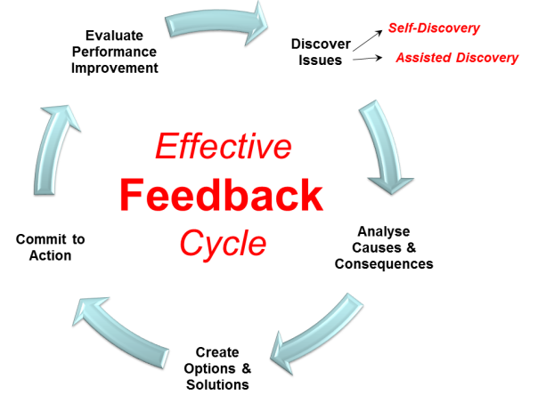
Continuous Process Improvement

Slide 48
Session II: Operating community Based employment Services
CIE

Slide 49


Qualities of Effective Employment Consultants
Principled Optimism
Cultural Competence
Business-Oriented Professionalism
Networking Savvy
Which of these do you think is the biggest challenge for you?
Select your response in the Poll

Slide 50
What we know…
Job development is more than just job placement
There is a job out there for everyone who wants one
Employment services should address both:
  The ‘supply’ side’ (job seeker’s interests, needs, supports and opportunities)
  The ‘demand side’ (what employers want and need)

Slide 51
Customized Positions
Are built around the needs of the job seeker and the business
Are new and/or re-allocated, re-assigned job tasks
It is not job carving (an existing positions that is adjusted or accommodated based on the job seeker’s skill deficits)
It is a completely different approach to job development

Slide 52
Employment Process
Person Centered Discovery Process
Exploration and Field Research
Evaluate Needs & Fit
Present Solutions (negotiate)
Group Brainstorm
Network for Contacts
Informational Interviews
Employment Placement
Target Employers

Slide 53
Discovery Process
Building a Profile to Target Employment Options

Slide 54
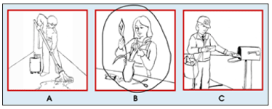
Typical Assessment Processes
Situational assessment in predetermined site/tasks
  Comparative, evaluative, stereotypical jobs
Interest surveys (Paper and Pencil)
  No experience- hard to make informed choices
Circle one:

Slide 55
Discovery
An individualized, qualitative process that results in a narrative description, a Jobseeker Profile
It is not comparative- or evaluative. It is not a test
It explores ideas based on job seeker’s input- not a pre-determined curriculum
Looks at the job seeker’s skills and passions and what business would value these attributes
It does not happen at a desk in a conference room. It is an active, engaging process

Slide 56
Exposure Proceeds Interest.
Interest Proceeds Motivation.
Motivation Proceeds Action.

Slide 57
The Purpose of Discovery
Generate new ideas for employment
Explore these new possibilities
Clarify abilities/skills/support needs
Identify themes and potential employment options
Create a profile of the job seeker to target potential employment options/settings
Helps a job seeker to imagine the possibilities, and see him/herself as a worker- an engaging, empowering process
It is the “means to the end”- keep it simple, make it quick

Slide 58
Discovery Process
How to do it in an efficient, yet effective way

Slide 59
Discovery Steps/Activities
Review of employment history & case records- be careful
Build a team of supporters ( not just paid staff)
Interview job seeker, family and friends in neutral place
Spend time with the job seeker in community setting
Outline skills and preferences, identify passions & themes
Brainstorm employment settings & possible tasks
Go look/try it out together- job shadow, volunteer
Create a discovery profile of the job seeker
Develop a plan/target employment options

Slide 60
Interviewing and Active Listening
Quick review person’s file for a historical perspective - be skeptical of voc. assessments and workshop reports
Meet at the person’s home or someplace neutral
Ask Open-ended questions
  “Tell me about yourself” “What do you do for fun?”, “What do plan to do after school?”, “What kind of work have you done?”, “ How did you meet Joe?”
  Closed Questions: “Do you like your job?”, “Do you have a pet?”
  Conversations vs. Interrogations
BE QUIET!
Take notes and ask for clarification

Slide 61

Tour the Neighborhood, Talk with Friends and Family
Take a walk with the person – Where do you go? Who are your friends? What do you like to do?
What do you do at home? Chores? Fun?
Identify potential sites/activities for “doing something together”
Identify additional people to interview
Any ideas for local employment?
Look at accessibility/transportation options.

Slide 62
What are we “Discovering”?
Dreams and goals
Talents
Skills and knowledge
Learning styles
Interests
Personality traits (Remember: quirks can be assets)
Values
Environmental preferences
Dislikes
Work experience
Support system
Challenges
Solutions (accommodations)
Temperament

Slide 63
Identify Interests and Values
Family & friends
Animals
Independence
Culture/heritage
Financial security
Music/art
Sports
Spirituality
Patriotic
Identify passions
What comes up again and again?
Reoccurring themes vs. a specific instance
Remember “Exposure Proceeds Interest”

Slide 64
Create a Descriptive, Qualitative Profile
Not evaluative or comparative
Treat as a living document
Format? Narrative Report? Profile? Both?
Approved/signed by job seeker
Information presented should be reflected in employment plan- and placement outcomes

Slide 65
Research ideas with job seeker
Ask people to share personal and professional contacts
Follow-up meeting with job seeker. Revisit list of possible sites- discuss each businesses, show the person websites, visual information. job shadow primary ones, observe reactions/level of interest.
Research ideas in the field (sometimes with, sometimes without the job seeker)
Start researching and networking for a contact for #1 choice
Find the perfect spot? Next step: Engage with Business

Slide 66
Job Development Plan
Summarizes ideas generated from process
Identifies key characteristics and clarifies individual’s employment goals, desired hours, other logistical concerns
Outlines next steps and person responsible
For those who wish to proceed with a specific type of job or “negotiated position” the report should identify specific employers/businesses to research and approach (As part of Venn process, we list 10 to start)

Slide 67
Building Business Relationships
You never “close” a sale, you open a long-term relationship” -Dennis Waitley

Slide 68
What do Employers Value and Need?
Motivated employees who are excited about their work.
Candidates with skills sets that can add value to their workforce.
Business solutions that improve the company’s productivity and/or workflow.
Reliability/dependability
Availability/flexibility
Productivity/Quality (Owens, 2007)

Slide 69
Most businesses have needs, get to them before a position has been posted
80% of Job seekers only
Apply for posted positions.
Only 20% of Jobs are ever posted.
20%
80%

Slide 70
Everyone is a job developer!
Everyone in your agency– set up a white board
The Job seeker’s personal network should also be tapped
Find “warm” contacts– no more cold calls
Professional services – doctors, chiropractors, banker, plumber, barber, how many do you know?
Personal associations – religious, political or business affiliations, how many do you know?
Notes:
70

Slide 71
The Art of Networking
YOU
GOALS

Slide 72
Employer Engagement
Reframing how we approach and partner with business

Slide 73
Job Development Process
Employer Contact
Informational Interview
Presentation
Negotiation
Placement

Slide 74
Contact Employers:
Check Your Message
Social Service vs. Employment Service

Slide 75
Key Things to Remember
Make it Brief – getting message across to a stranger in the time it takes to ride an elevator a few floors
Remember to create positive image
Convey competence/quality, not human service or charity
EXCHANGE BUSINESS CARDS!
An employer’s business card is like gold!

Slide 76
Use Positive Language and
Business Terminology
Do not sell “disability” – not about charity and tax credits
No social service lingo or acronyms
Candidates vs. clients/consumers
“Systematic , routine tasks”, “entry level” vs. “easy, menial, “repetitive work”
Recruit and screen candidates vs. job development
Business tools and principles (i.e. Lean, Six Sigma)
“Orientation and training” vs. job coaching
Tools vs. accommodations

Slide 77

“An innovative staffing resource”
“Assisting people with disabilities to achieve employment”

Slide 78
What do employers WANT to hear from us?
We represent…
Motivated employees who are excited about working
Candidates with skills sets that add value to their workforce.
Business solutions that improve the company’s productivity and/or workflow.

Slide 79
Informational Interactions
Talk to employers, learn about their businesses

Slide 80
Goal of Informational Interview
r
Do you have any jobs?
I’d like to learn more about your company
P

Slide 81
Informational Interactions:
Focus is on the Business/Industry
The conversation is NOT about “the job seeker”
Gain an understanding of the work flow processes, “set-up/button-up” roles, essential skills and workplace culture
Opportunity to check your “pre-conceptions”
It is also an opportunity to build a relationship and sense of trust with the employer
Identifying challenges (workflow issues, staffing needs,…)
Is this a “prospect” for your candidate? (Can your candidate can solve problems or add value?)

Slide 82
Networking and Informational Interactions
Find a contact (warm vs. cold) - have coffee/lunch
Determine who is the right person/right department
Ask open questions. Remember this is a conversation, not an interrogation- and it is definitely not a sales pitch.
The conversation is NOT about “the job seeker”
Gain an understanding of the work flow processes, critical roles and “set-up/button-up” tasks, essential skills and workplace culture
Leave your pre-conceptions at the door- be ready to be surprised

Slide 83
Connect with Targeted Business
Research the companies you targeted for your job seeker:
Identify key products/services
Critical positions (Who are the “rain makers”?)
Look at company culture and values
Is the company growing? Merging? Shrinking? Start-up? Trends in the industry?
Who are their competition– what sets them apart?
Recent events? (good and bad)
Who might you talk with?

Slide 84
How do you get in the door?
Do not lead with “disability”
A good opening line…
  “I work with job seekers interested in your industry. My Friend, Mary Smith, said you are an expert in the field and might be able to help me.”
Make your initial request easy…
  “Can I come and see what you do and talk to you about the skills sets needed to work in this field.”
Elevator Speech for your organization.
  “Who are you with? What does your organization do from the perspective of an employer?” (Do NOT sell disability)

Slide 85
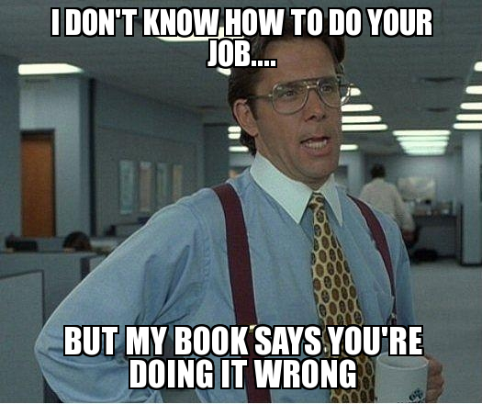

The Right Person may not be HR
HR is responsible for the bigger picture (strategy, projections, policies) and hiring/managing the workforce
HR’s role is not necessarily understanding the nuisances of the work/jobs being done.
Sometimes HR is the last to know that there are staffing issues in a department
Customizing Jobs is also about Process Improvement
We need to talk to the people doing the work.

Slide 86
Informational Interactions
Foot in the door
Low pressure
Chance to make a great first impression
Start of working relationship
Uncover possible opportunities

Slide 87
Look for Issues/Challenges
Possible ways to improve workflow
Customer /employee complaints
Log jams/backlogs/ long lead times/Waiting
Unassigned, but critical tasks
Burn-out or high turnover
Managers or key staff pulled away from core tasks
Workflow fluctuations
  Rush times, crunch times, seasonal fluctuations, sporadic- but important tasks that are not getting done

Slide 88
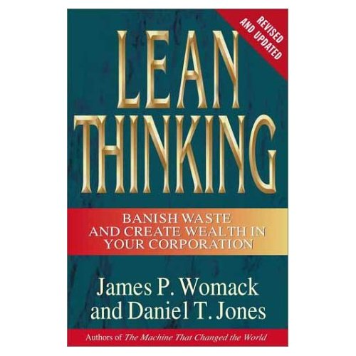
Lean Principles- a job developer’s toolkit
A process improvement approach that focuses on the customer and seeks to identify “WASTE” and inefficient processes
Learn to talk the language of business

Slide 89
Ways to improve processes and “workflow”
What is the product (or service)?
  Are there ways to make product faster?
  Are there ways to make product cheaper? Save money?
  Are there ways to increase the number of customers served or improve customer service?
  Are the customers (and staff) happy?
      $.80 to keep a customer, $3.00 to make a new one

Slide 90
Look for “Waste”
Wasted Talent
  Identify who are the “surgeons” (aka highly paid or income-generating staff) Are they doing surgery?
  What are the set-up and button-up tasks for supporting the essential work?
Wasted Time
  Orders not processed because too busy taking new ones
  Machines/supplies not maintained- work stops
Wasted Resources
  Inventory- supplies never used or too much of what is needed
  Overproduction- 50 kits - we ordered 1,000.. expired, obsolete.
  Is the employer using temporary workers? Paying overtime?

Slide 91

Is it a good fit for your Job Seeker?
Possible scenarios:
  Not right – keep the connection “percolating” by proposing other services such as worksite tours, job shadows or disability awareness training
  It’s perfect! Needs, Environment, matches skills and interests – It’s time to write a proposal and talk jobs
  Regardless, always send a thank you!!

Slide 92
Assignment 5
Get to Know an Employer Through an Informational Interactions

Slide 93
Negotiating Opportunities
Presenting a Proposal with business solutions/services and job candidate

Slide 94
The Pitch (aka the employment proposal)
Framing your ideas and presenting a candidate

Slide 95
Identify tasks (from a refined task list) that might be assigned, re-assigned, or even created.
Employment Proposal
STEP 1

Slide 96
Present Your Ideas/Solutions with a
Potential Task List
Translates the job seeker’s Features to Benefits
Based on employer’s needs and your candidate’s skill set
Helps an employers to focus on job tasks- not job postings or existing positions
Demonstrates how a person with disabilities can be can add value to their workforce

Slide 97
Effective Tasks Lists
Gets the employer thinking--and talking about tasks (vs. job postings)
Speak the employer’s language
  Use employer’s jargon and organizational terms
List specific job tasks (doing what for whom?)
  not general statements like “file”, “photocopy”
List most important tasks (needs) first
  Which tasks will have the greatest impact?

Slide 98
Highlight the skills of the candidate and how they can match the tasks needing to be done. Outline how these tasks might be assigned to the jobseeker you represent.
Employment Proposal
STEP 2

Slide 99
Delineate the potential benefits to the employer as a result of assigning identified tasks to the job candidate.
Employment Proposal
STEP 3

Slide 100
Benefits for Employers
Cost effective way to improve work flow and reduce waste
Supports core staff so they are able to concentrate on key aspects of their positions
Productive, dependable, loyal employees
Reduces recruitment and training costs for support positions
Diversifies the workforce
Leverages resources of employment service to assist with orientation and training of the new employee.
Expertise and resources for managing disabilities in the workforce

Slide 101
Cost-Savings Analysis: Close the deal
Estimates cost savings by not utilizing highly-trained staff to do basic, routine tasks
Not always included, only when there is a cost savings (i.e. highly paid staff are freed up to do more critical tasks)
Projecting costs over 5-year period demonstrates additional savings due to Cost of Living Adjustments (COLA)

Slide 102
Discuss your role (and your organization’s role) in supporting the job candidate.
Employment Proposal
STEP 4

Slide 103
Make the ASK. “I believe this candidate would be a wonderful asset to your organization. Would you be willing to consider this proposal?”
Employment Proposal
STEP 5

Slide 104
Reiterate the potential benefits of the arrangements to the employer – e.g., how others can produce more, money can be saved, more sales will be generated, etc.
Employment Proposal
STEP 6

Slide 105
“We’re not hiring” to “When can he start?”
Our candidates had skills and attributes the employers valued
Both candidates were extremely interested in the business
Job developer identified needs and presented a cost effective solution to the employer’s problems
Job developer helped the employer to understand how to utilize the candidates’ skills and accommodate their disabilities

Slide 106
Negotiation is successful when all agree to…
What tasks need to be done
What tasks the individual can do
What hours the individual will work
Production requirements
How much the individual will be paid
What accommodations and supports will be necessary
The benefit to the business

Slide 107
Lessons Learned
Hiring is a business decision– position must add value to the workforce
Participate in business groups
Network! Build relationships
Develop employment proposals
Follow-up with all employers all the time
The employer “buys” you before they “buy” your candidate

Slide 108
TOOLS – Employment Process Guide featuring:
Positive Personal Profile
Discovery and Assessment Process Log
Features to Benefits Form
Job Development Plan
Informational Interview Form/Questions and Job Skills Inventory
Employer Proposal Letter

Slide 109

Tracking Job Development Activity
Placements
Presentation
Proposals
Informational
Interviews
CONTACTS

Slide 110
Supporting Job Development Activity
 | Contacts | Inform Interviews | Presentations | Placements
Michelle | 20 | 4 | 2 | 2
John | 10 | 8 | 6 | 2
Mama Cass | 12 | 8 | 6 | 4
Denny | 16 | 8 | 2 | 2

